Slide 1
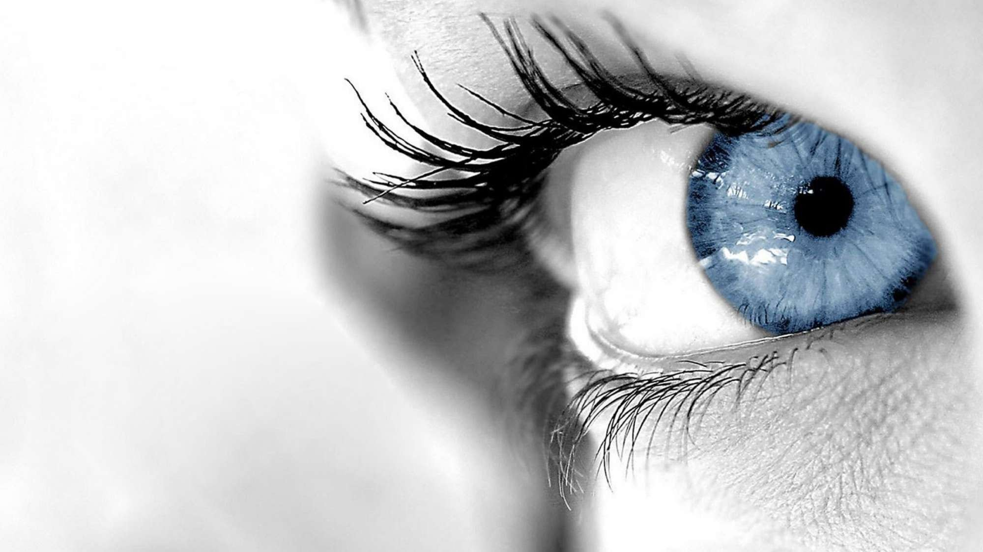
Deep Learning for Computer Vision
6.S191 Introduction to Deep Learning
introtodeeplearning.com ^{1/29/19}

Slide 2
What Computers “See”

Slide 3

Images are Numbers
[1] 1/29/19

Slide 4
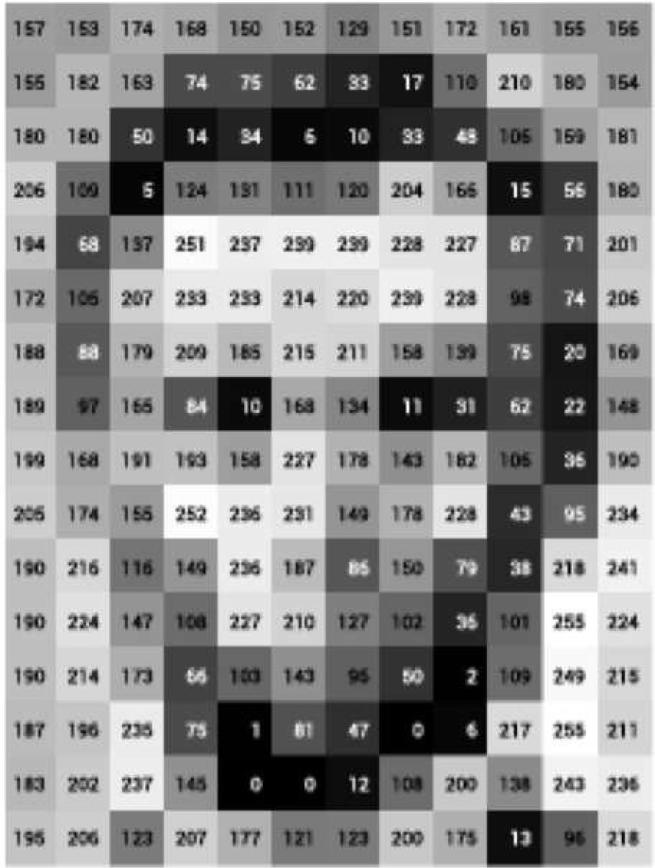
Images are Numbers
[1] 1/29/19

Slide 5
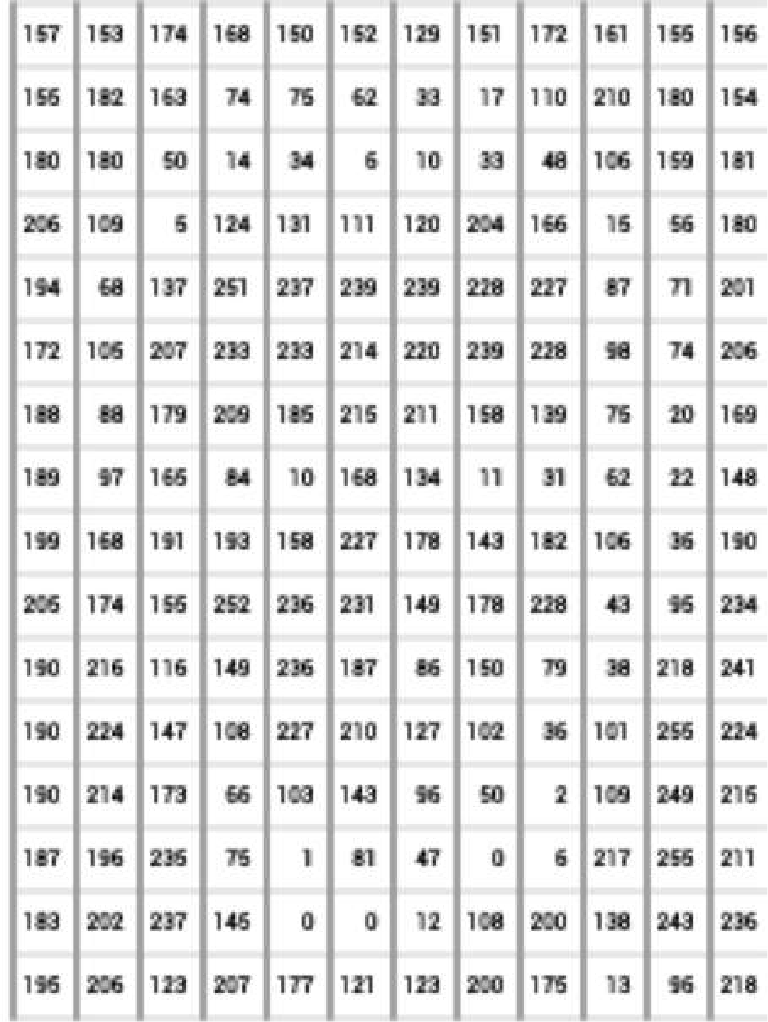
Images are Numbers
What the computer sees
An image is just a matrix of numbers [0,255]! i.e., 1080x1080x3 for an RGB image
[1] 1/29/19

Slide 6

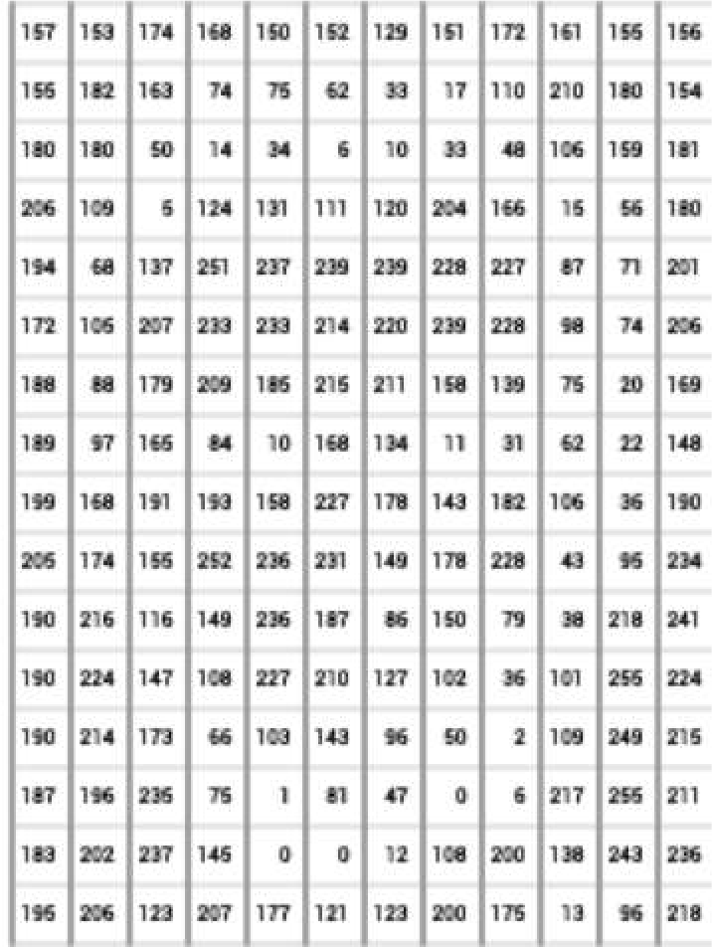
Tasks in Computer Vision
Lincoln
0.8
Washington
0.1
classification
Jefferson
0.05
Obama
0.05
Input Image Pixel Representation
Regression: output variable takes continuous value
Classification: output variable takes class label. Can produce probability of belonging to a particular class
1/29/19

Slide 7
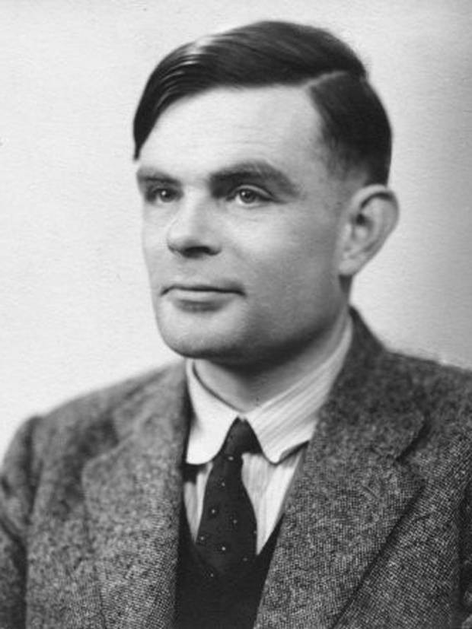
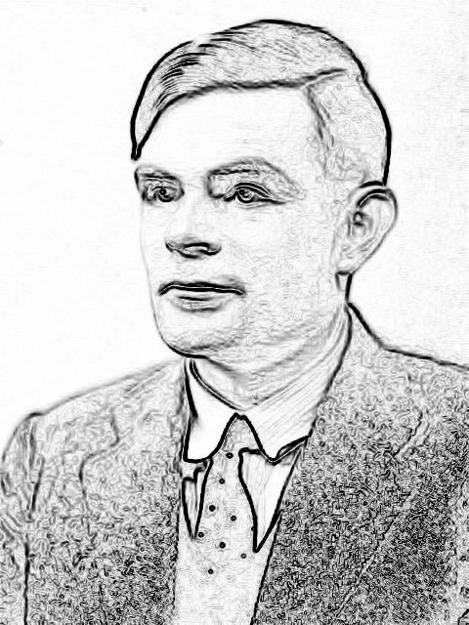






How to teach a machine ?
edges
classifier
Person
(or any other hand-crafted features)

Slide 8

How to teach a machine ?
edges
classifier
od representation
Person
o
Not a g
(or any other hand-crafted features)

Slide 9
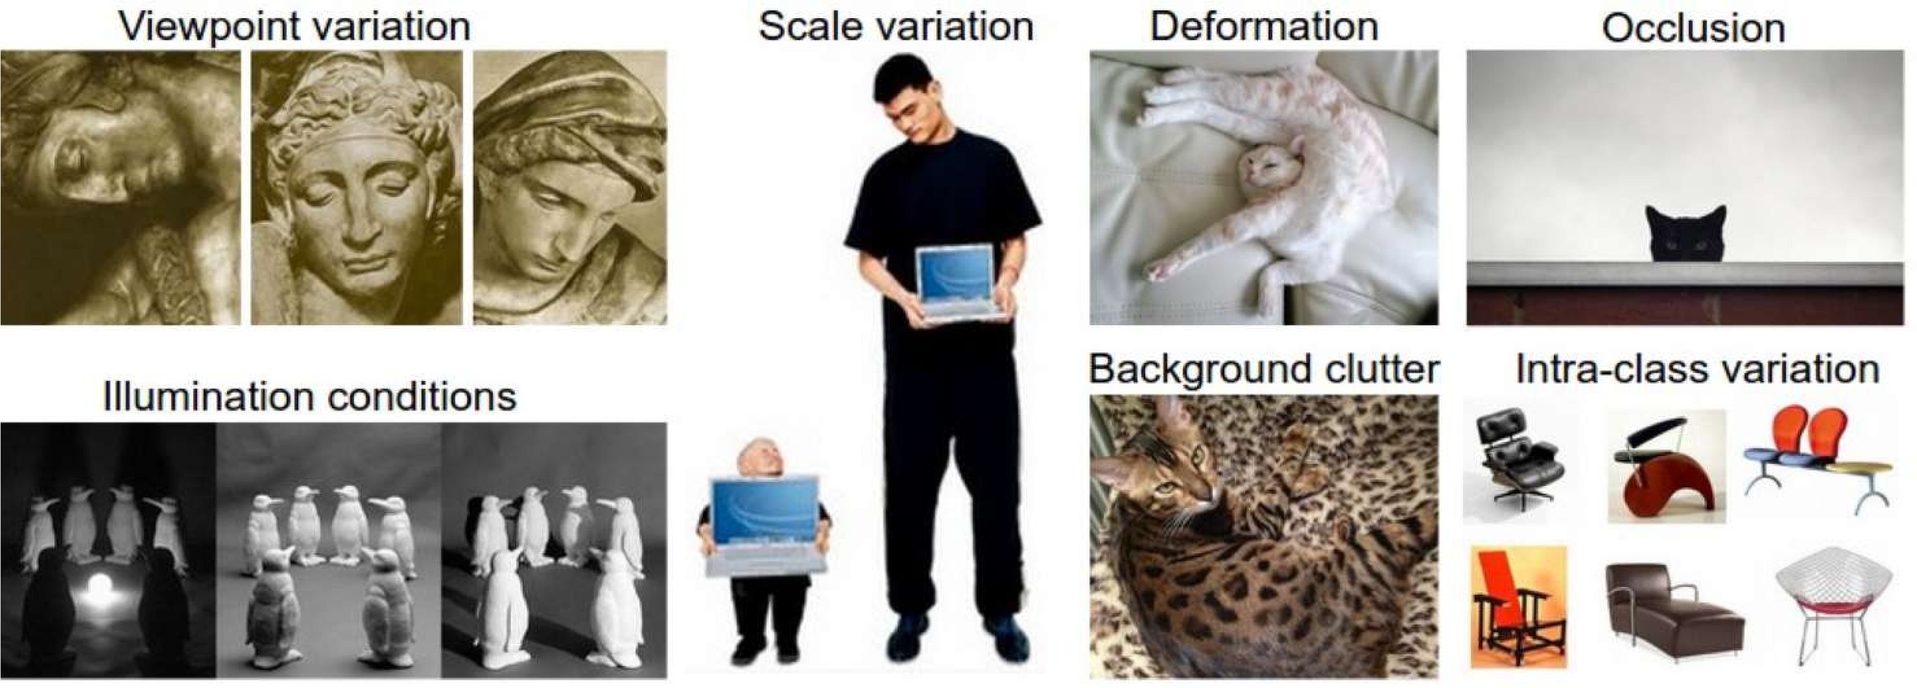
Manual Feature Extraction
Detect features to classify
Domain knowledge
Define features
[2] 1/29/19

Slide 10
Manual Feature Extraction
Detect features to classify
Domain knowledge Define features
[2] 1/29/19

Slide 11
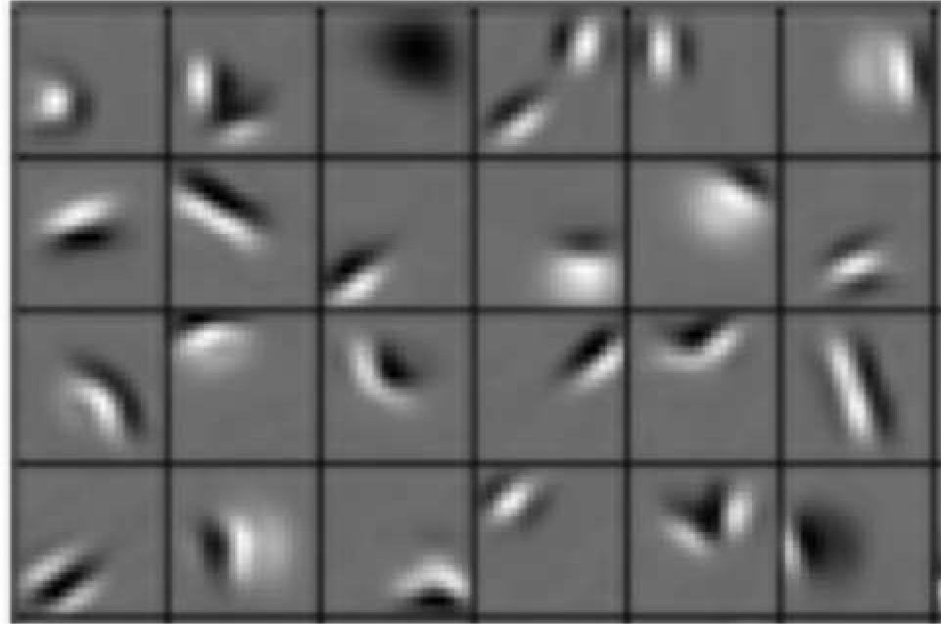
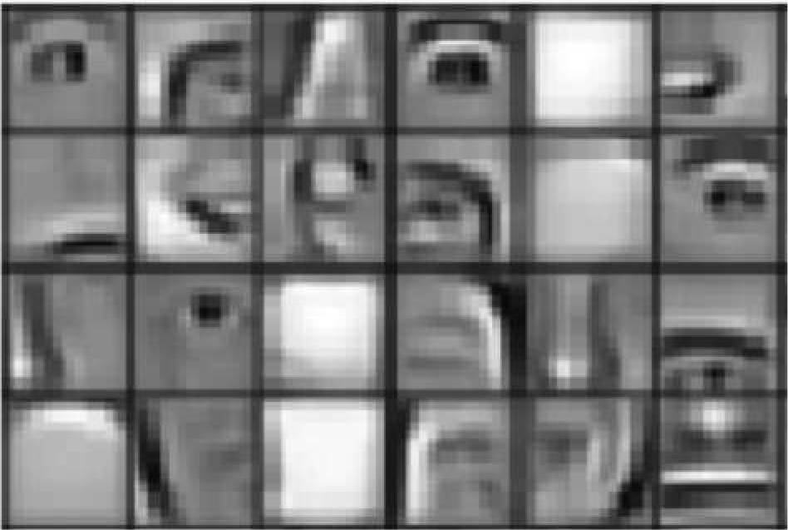
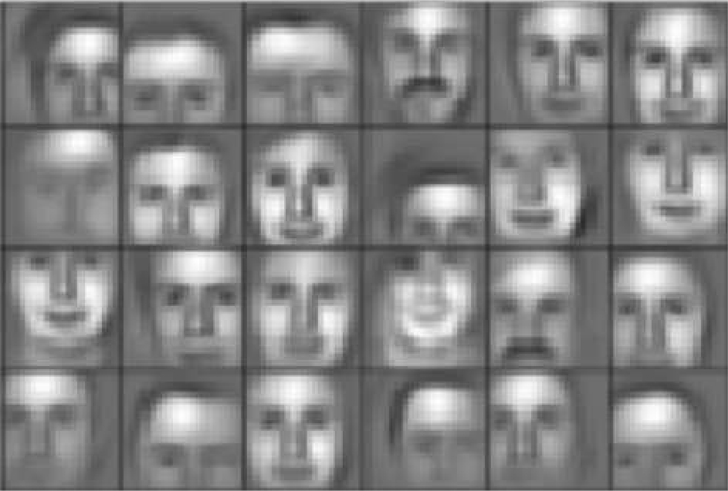
Learning Feature Representations
Can we learn a hierarchy of features directly from the data instead of hand engineering?
Low level features Mid level features High level features
Edges, dark spots
Eyes, ears, nose
Facial structure
[3] 1/29/19

Slide 12
Learning Visual Features

Slide 13
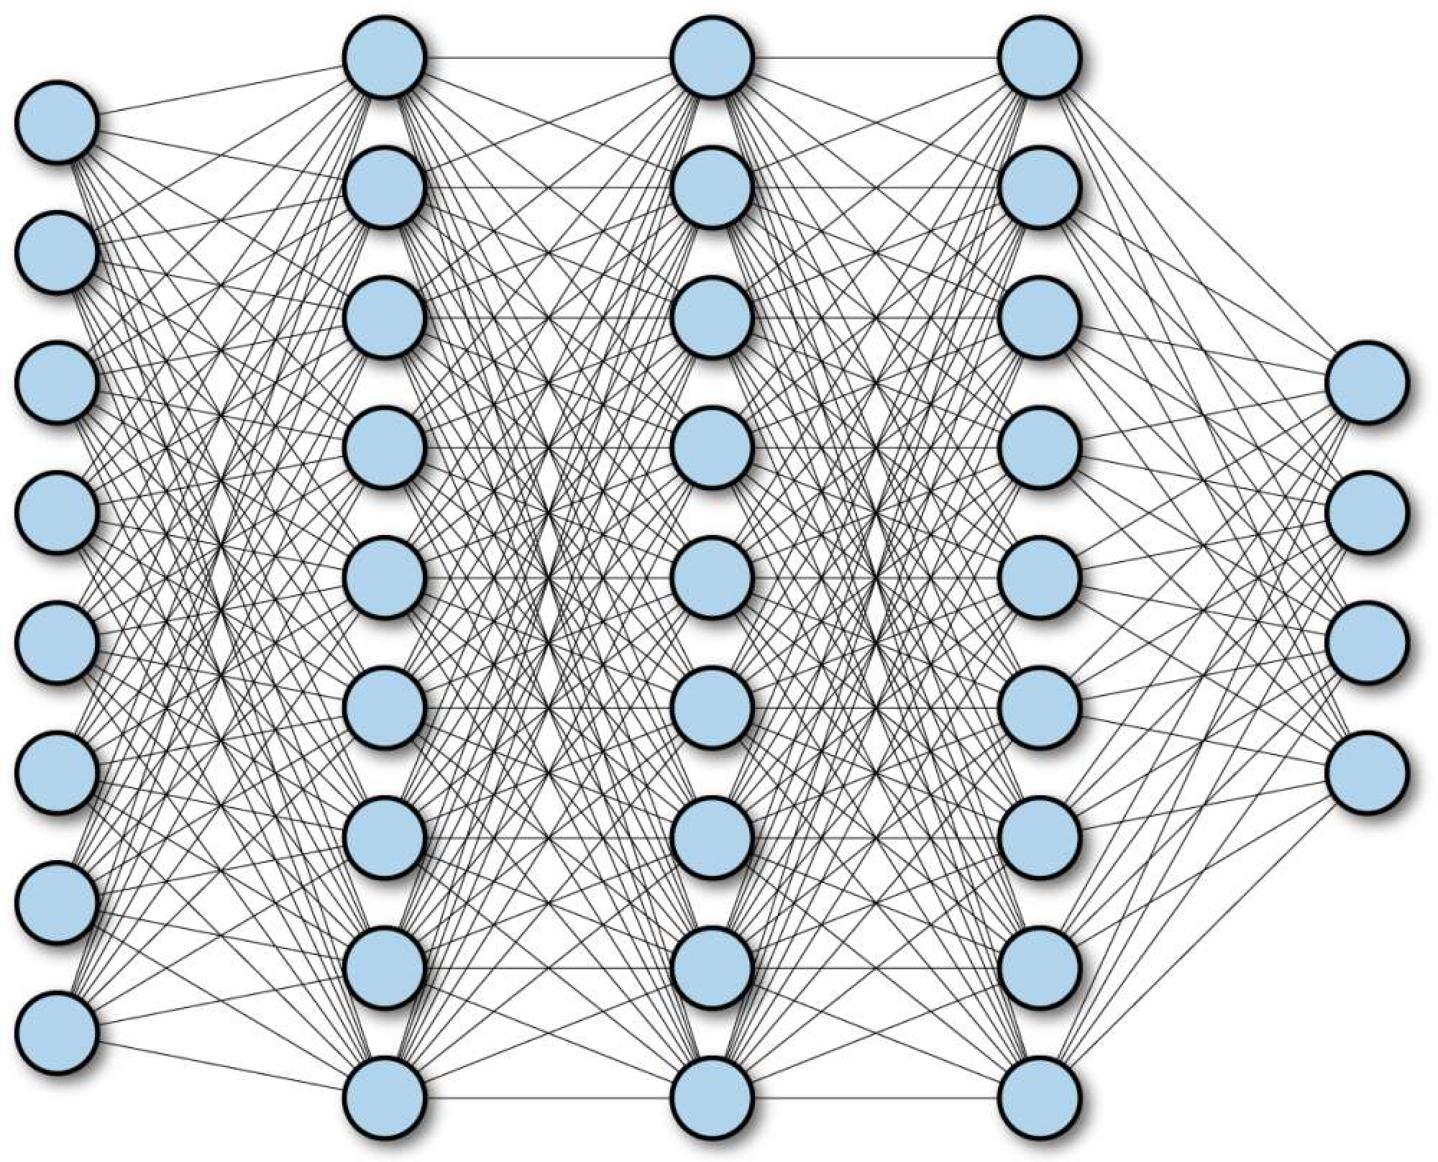
Fully Connected Neural Network
1/29/19

Slide 14
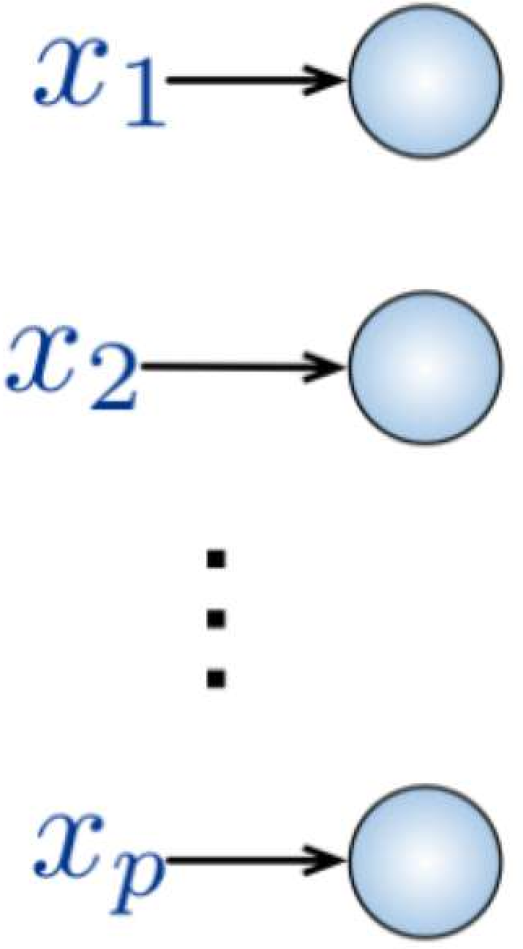
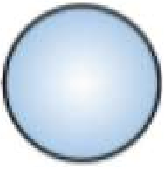
Fully Connected Neural Network
Input:
2D image
Vector of pixel values
Fully Connected:
Connect neuron in hidden layer to all neurons in input layer
No spatial information!
And many, many parameters!
1/29/19

Slide 15
Fully Connected Neural Network
Input:
2D image
Vector of pixel values
Fully Connected:
Connect neuron in hidden layer to all neurons in input layer
No spatial information!
And many, many parameters!
How can we use spatial structure in the input to inform the architecture of the network?
1/29/19

Slide 16
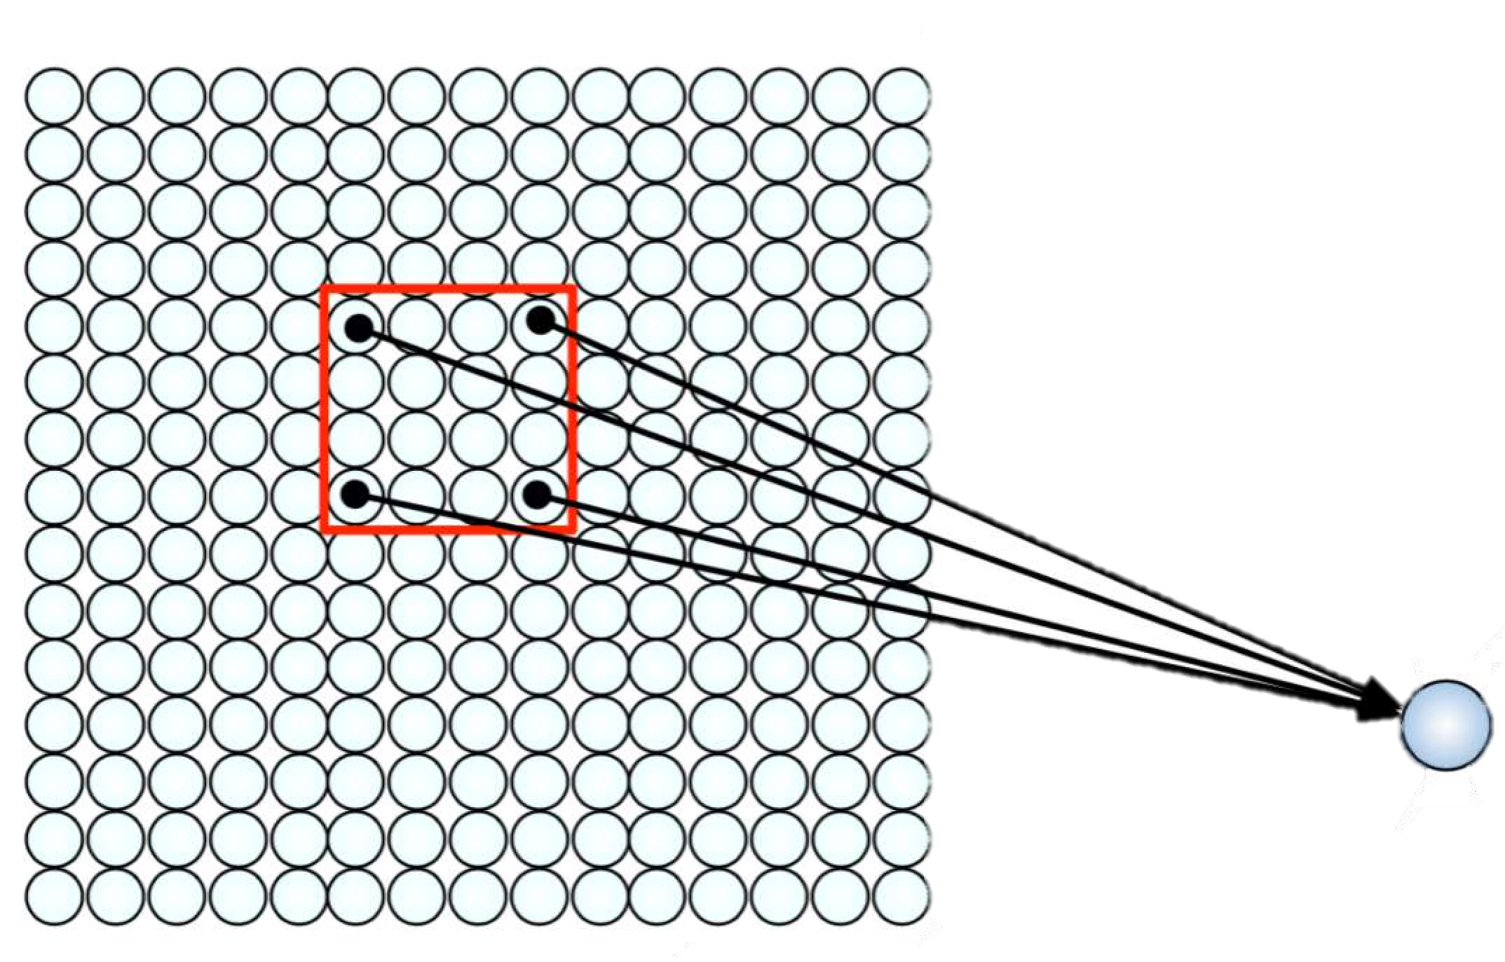
Using Spatial Structure
Input: 2D image.
Array of pixel values
Idea: connect patches of input to neurons in hidden layer.
Neuron connected to region of input. Only “sees” these values.
1/29/19

Slide 17
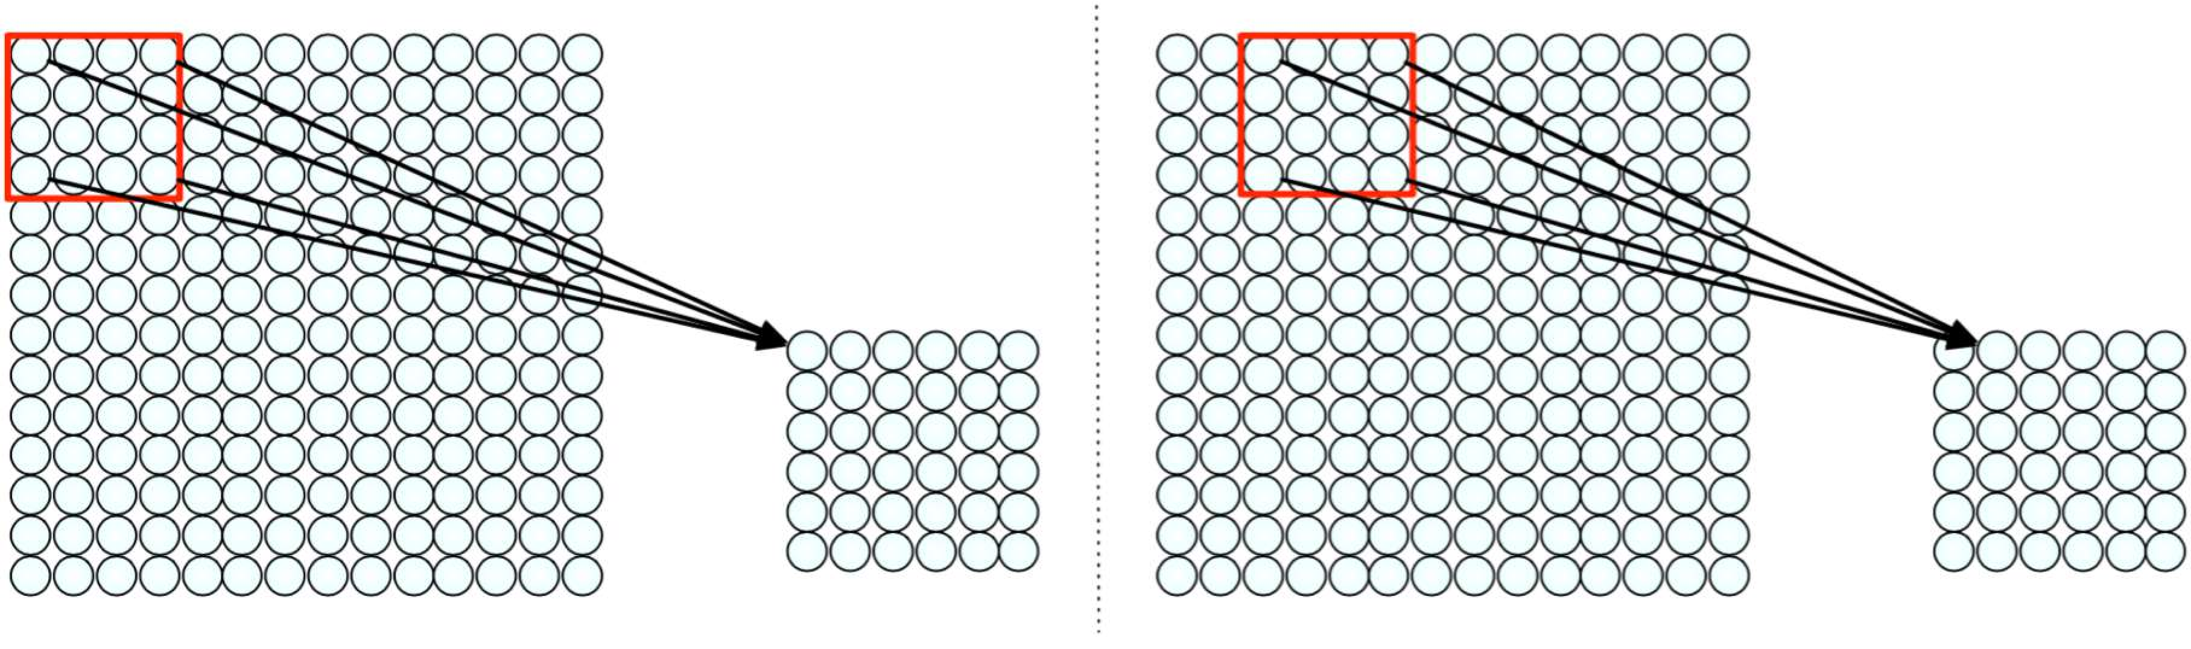
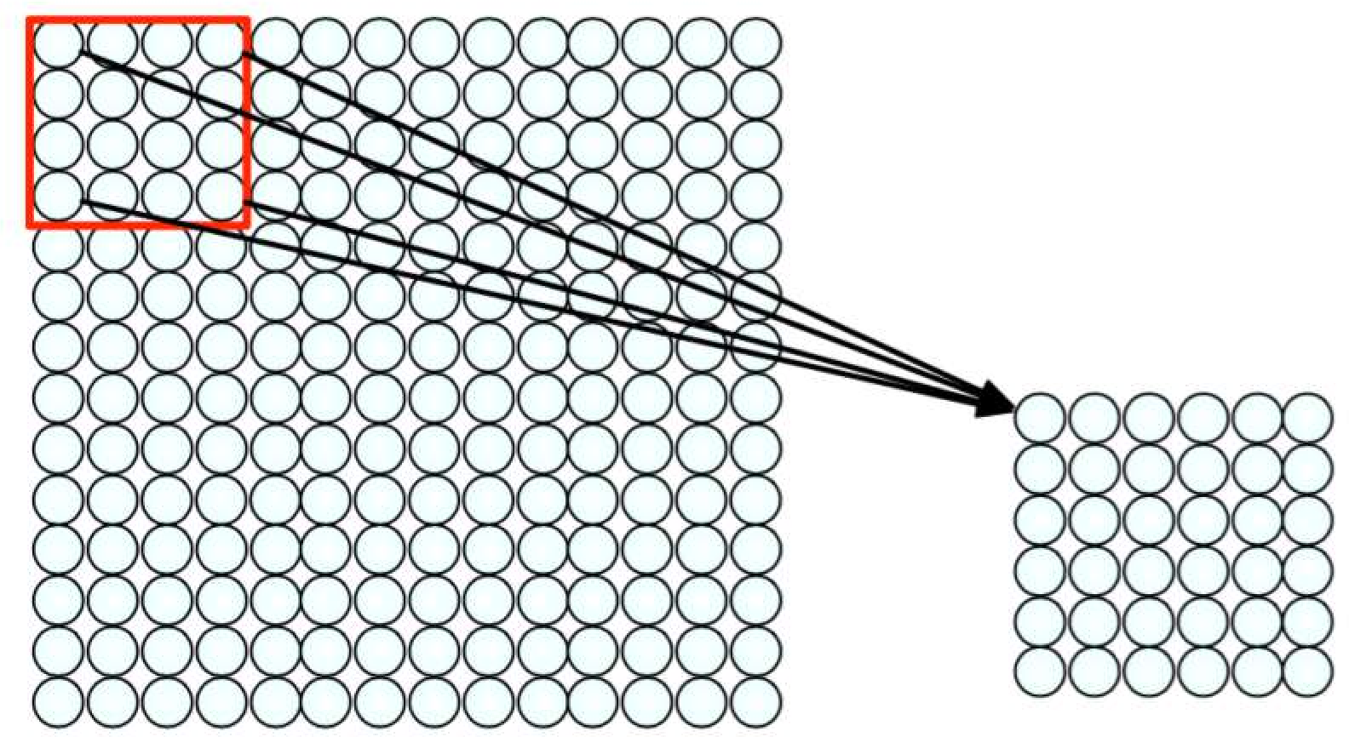
Using Spatial Structure
Connect patch in input layer to a single neuron in subsequent layer.
Use a sliding window to define connections.
How can we weight the patch to detect particular features?
1/29/19

Slide 18
Applying Filters to Extract Features
Apply a set of weights – a filter – to extract local features
Use multiple filters to extract different features
Spatially share parameters of each filter
(features that matter in one part of the input should matter elsewhere)
1/29/19

Slide 19
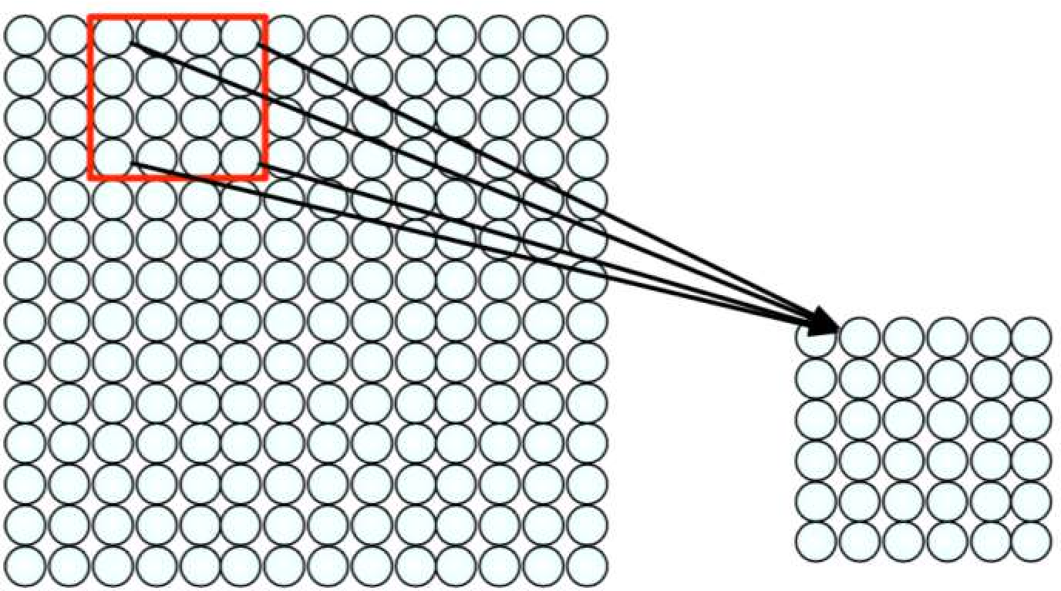
Feature Extraction with Convolution
Filter of size 4x4 : 16 different weights
Apply this same filter to 4x4 patches in input
Shift by 2 pixels for next patch
This “patchy” operation is convolution
Apply a set of weights – a filter – to extract local features
Use multiple filters to extract different features
Spatially share parameters of each filter
1/29/19

Slide 20
Feature Extraction and Convolution
A Case Study

Slide 21
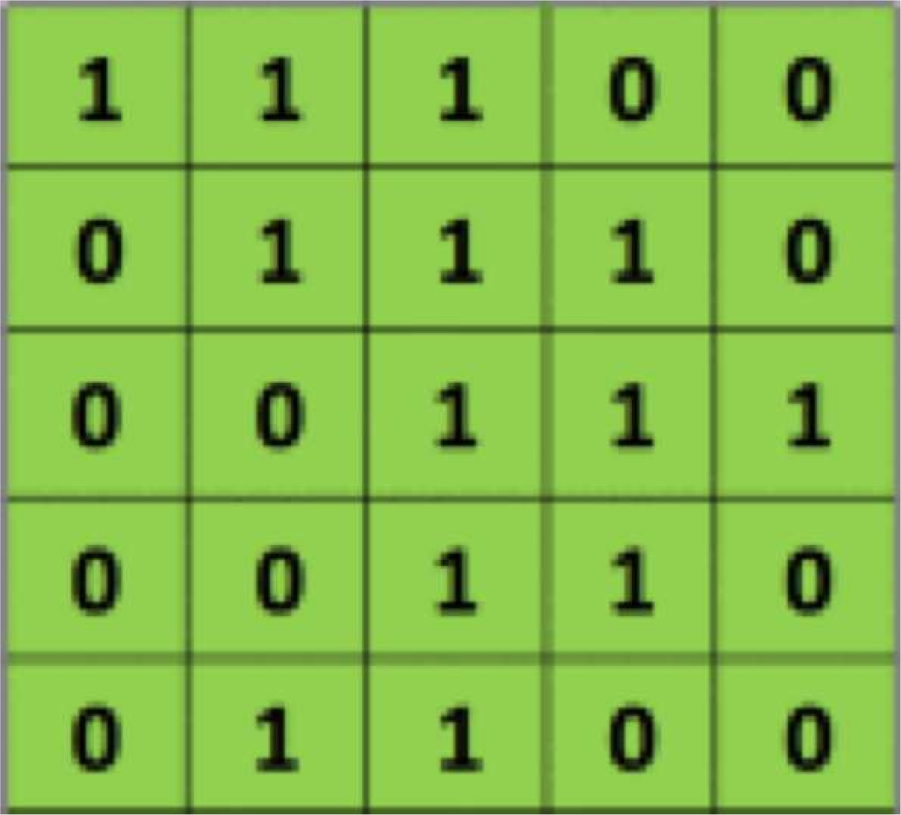
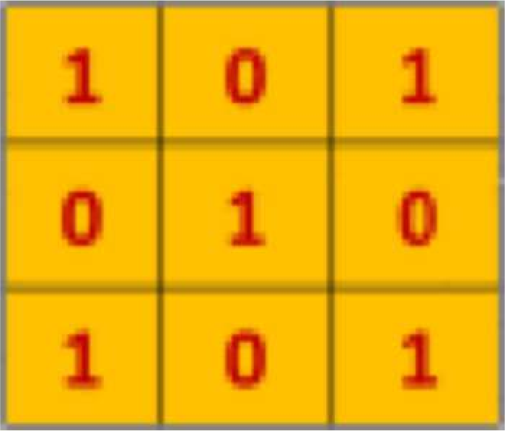
The Convolution Operation
Suppose we want to compute the convolution of a 5x5 image and a 3x3 filter:
filter
image
We slide the 3x3 filter over the input image, element-wise multiply, and add the outputs…
[5] 1/29/19

Slide 22
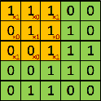
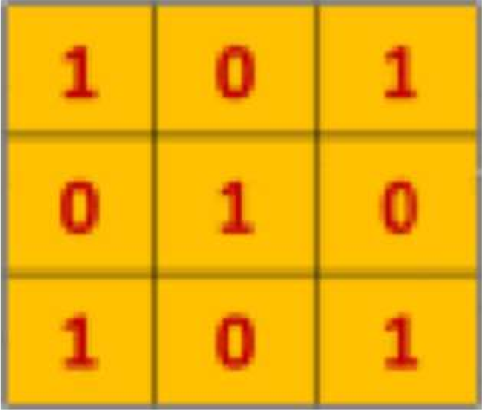
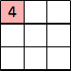
The Convolution Operation
We slide the 3x3 filter over the input image, element-wise multiply, and add the outputs:
filter
feature map
[5] 1/29/19

Slide 23
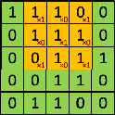
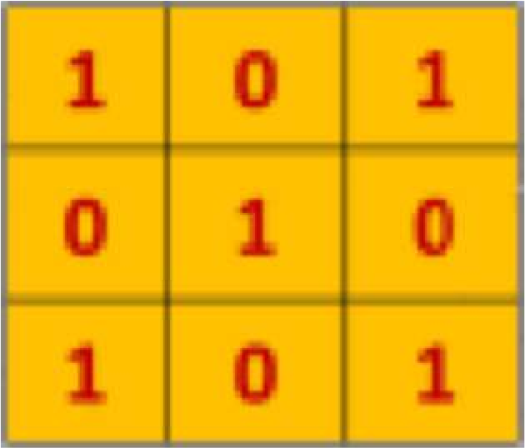
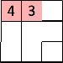
The Convolution Operation
We slide the 3x3 filter over the input image, element-wise multiply, and add the outputs:
filter
feature map
[5] 1/29/19

Slide 24
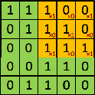
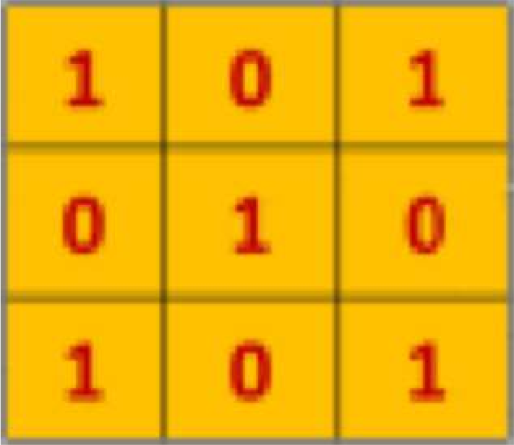
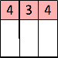
The Convolution Operation
We slide the 3x3 filter over the input image, element-wise multiply, and add the outputs:
filter
feature map
[5] 1/29/19

Slide 25
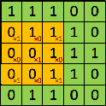
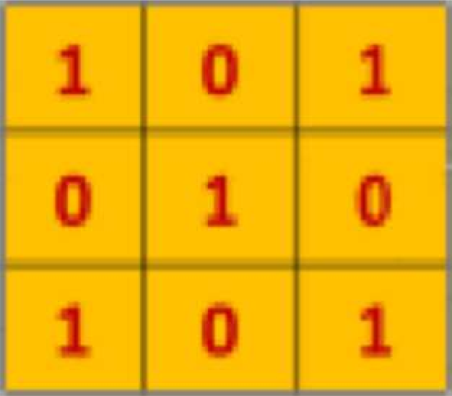
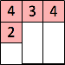
The Convolution Operation
We slide the 3x3 filter over the input image, element-wise multiply, and add the outputs:
filter
feature map
[5] 1/29/19

Slide 26
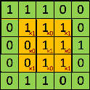
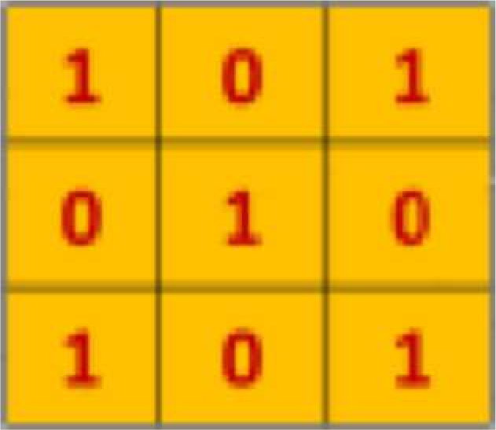
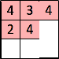
The Convolution Operation
We slide the 3x3 filter over the input image, element-wise multiply, and add the outputs:
filter
feature map
[5] 1/29/19

Slide 27
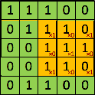
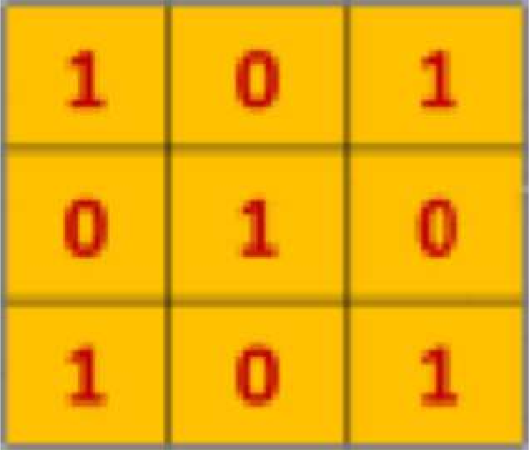
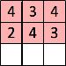
The Convolution Operation
We slide the 3x3 filter over the input image, element-wise multiply, and add the outputs:
filter
feature map
[5] 1/29/19

Slide 28
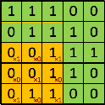
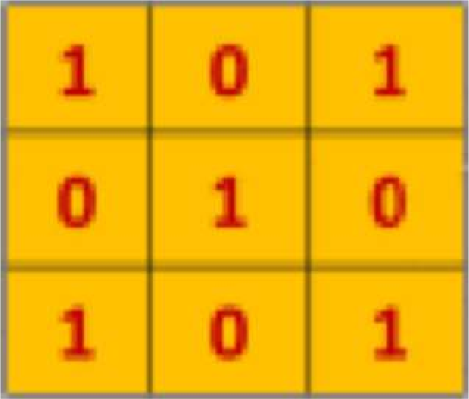
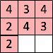
The Convolution Operation
We slide the 3x3 filter over the input image, element-wise multiply, and add the outputs:
filter
feature map
[5] 1/29/19

Slide 29
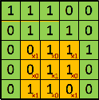
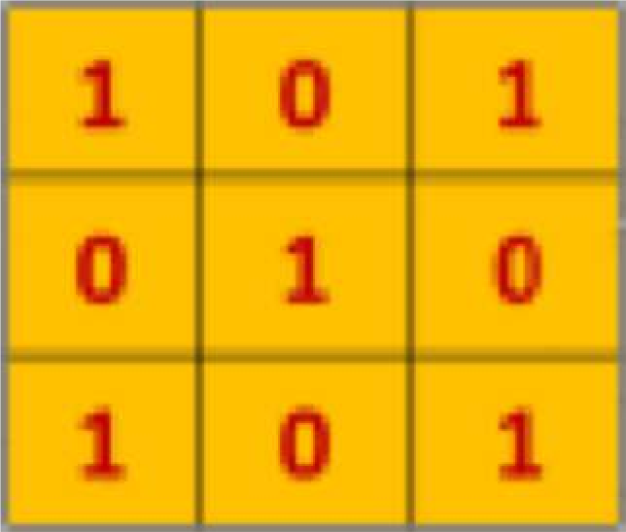
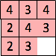
The Convolution Operation
We slide the 3x3 filter over the input image, element-wise multiply, and add the outputs:
filter
feature map
[5] 1/29/19

Slide 30
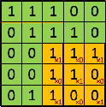
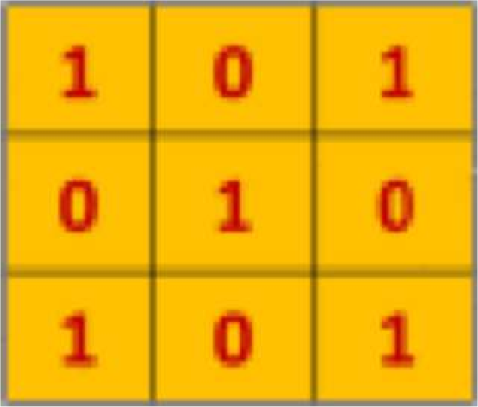
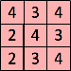
The Convolution Operation
We slide the 3x3 filter over the input image, element-wise multiply, and add the outputs:
filter
feature map
[5] 1/29/19

Slide 31
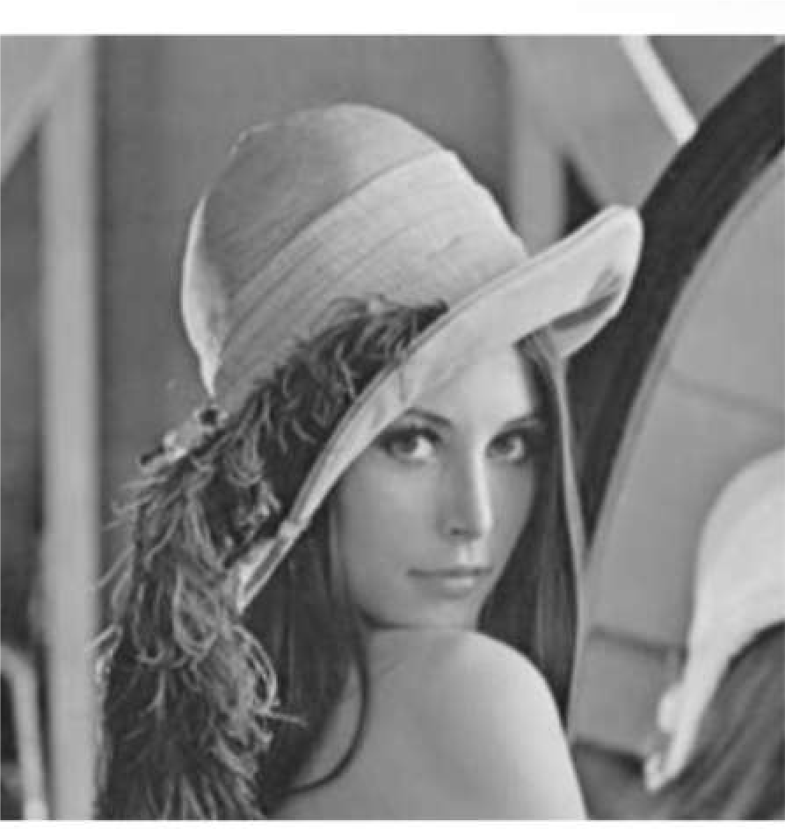
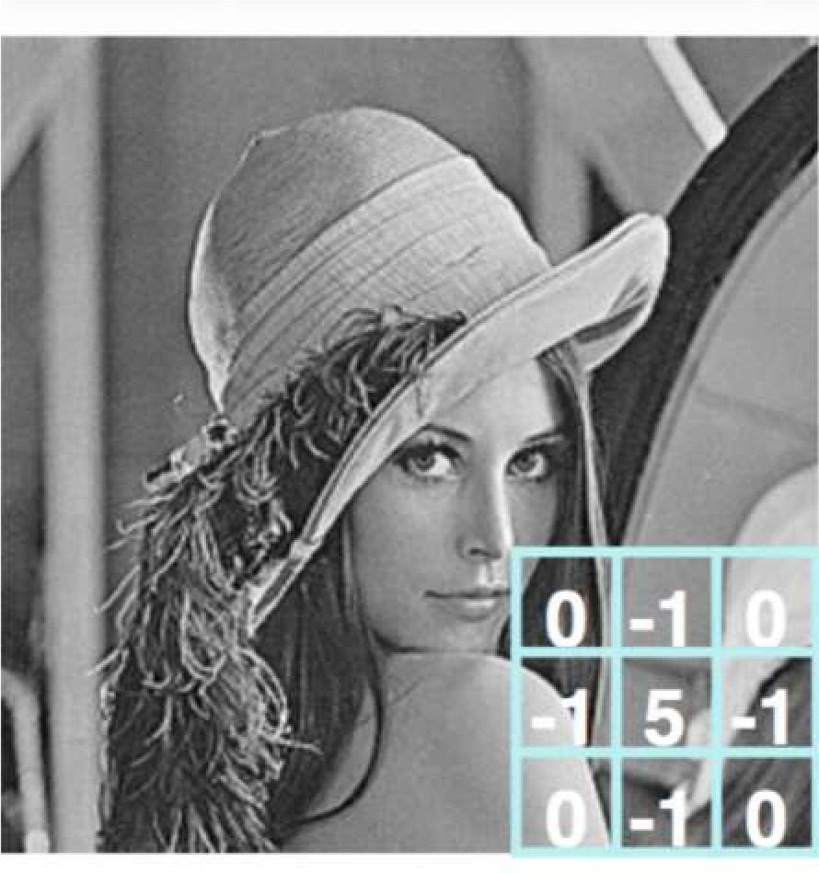
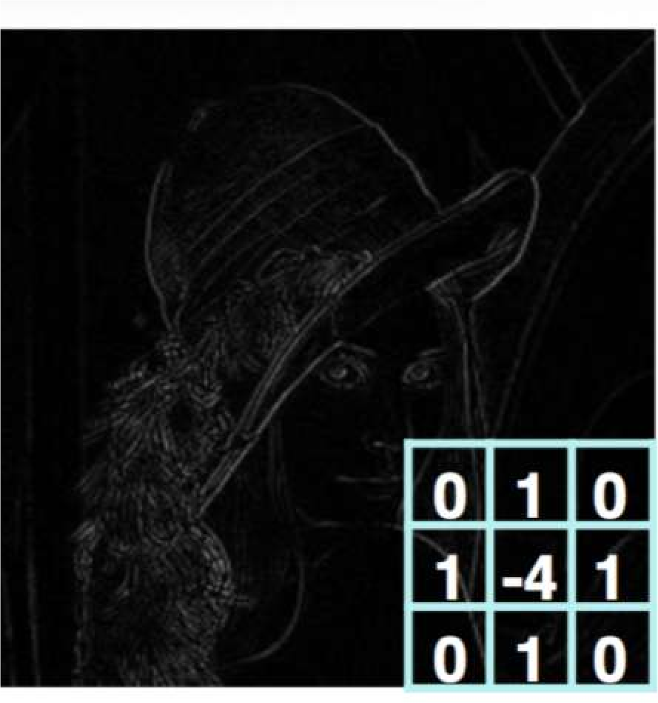
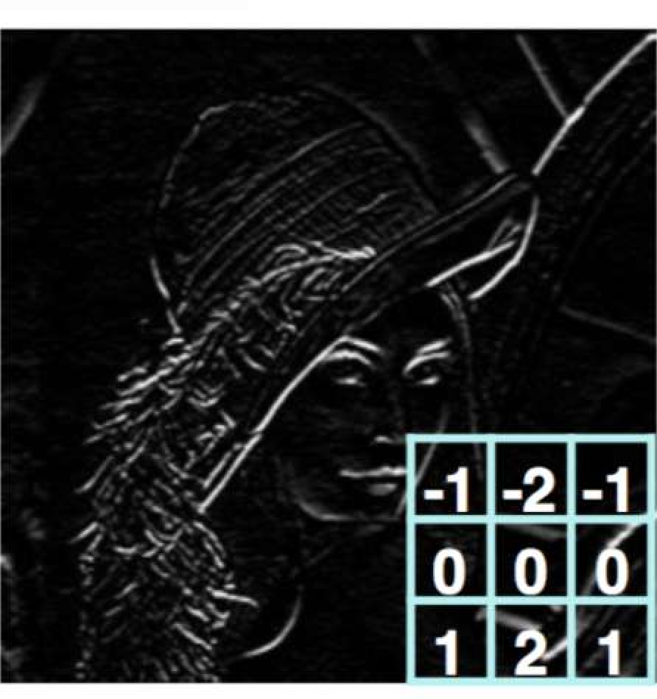
Producing Feature Maps
Original
Sharpen
Edge Detect
“Strong” Edge Detect
1/29/19

Slide 32

Feature Extraction with Convolution
Apply a set of weights – a filter – to extract local features
Use multiple filters to extract different features
Spatially share parameters of each filter
1/29/19

Slide 33
Convolutional Neural Networks (CNNs)

Slide 34

CNNs for Classification
Convolution: Apply filters with learned weights to generate feature maps.
Non-linearity: Often ReLU.
Pooling: Downsampling operation on each feature map.
Train model with image data.
Learn weights of filters in convolutional layers.
1/29/19

Slide 35

Convolutional Layers: Local Connectivity
For a neuron in hidden layer:
Take inputs from patch
Compute weighted sum
Apply bias
1/29/19

Slide 36

CNNs: Spatial Arrangement of Output Volume
depth
Layer Dimensions:
ℎ * w * d
where h and w are spatial dimensions
height
d (depth) = number of filters
Stride:
Filter step size
Receptive Field: Locations in input image that a node is path connected to
width
[3] 1/29/19

Slide 37


Introducing Non-Linearity
Apply after every convolution operation (i.e., after convolutional layers)
ReLU: pixel-by-pixel operation that replaces all negative values by zero. Non-linear operation!
Rectified Linear Unit (ReLU)
f x = max ( 0 , x )
[5] 1/29/19

Slide 38

Pooling
Reduced dimensionality
Spatial invariance
How else can we downsample and preserve spatial invariance?
[3] 1/29/19

Slide 39



Representation Learning in Deep CNNs
Low level features
Mid level features
High level features
Eyes, ears, nose Conv Layer 2
Edges, dark spots
Conv Layer 1
Facial structure
Conv Layer 3
[3] 1/29/19

Slide 40

CNNs for Classification: Feature Learning
Learn features in input image through convolution
Introduce non-linearity through activation function (real-world data is non-linear!)
Reduce dimensionality and preserve spatial invariance with pooling
1/29/19

Slide 41
CNNs for Classification: Class Probabilities
CONV and POOL layers output high-level features of input
Fully connected layer uses these features for classifying input image
Express output as probability of image belonging to a particular class
₊,₋
softmax (₎
⁼ ∑ +^{,0}
/
1/29/19

Slide 42
CNNs:Training with Backpropagation
Learn weights for convolutional filters and fully connected layers Backpropagation: cross-entropy loss
! " = $ &^{(%)} log -,^{(%)}
%
1/29/19

Slide 43
Pros & Cons
•
Best performing method in many Computer Vision tasks
•
Need of huge amount of training data
•
No need of hand-crafted features
•
Hard to train (local minima problem, tuning hyper-parameters)
•
Most applicable method for large- scale problems, e.g. classification of 1000 classes
•
Difficult to analyse (to be solved)
•
Easy parallelization on GPUs

Slide 44
CNNs for Classification: ImageNet

Slide 45












ImageNet Dataset
Dataset of over 14 million images across 21,841 categories
“Elongated crescent-shaped yellow fruit with soft sweet flesh”
1409 pictures of bananas.
[6,7] 1/29/19

Slide 46

ImageNet Challenge
Classification task: produce a list of object categories present in image. 1000 categories. “Top 5 error”: rate at which the model does not output correct label in top 5 predictions
Other tasks include:
single-object localization, object detection from video/image, scene classification, scene parsing
[6,7] 1/29/19

Slide 47

ImageNet Large Scale Visual Recognition Challenge (ILSVRC) winners
First CNN-based winner
Fei-Fei Li & Justin Johnson & Serena Yeung Lecture 9 - May 2, 2017

Slide 48
AlexNet
Krizhevsky, Alex, Ilya Sutskever and Geoffrey E. Hinton Imagenet classification with deep convolutional neural networks",
Advances in neural information processing systems, 2012

Slide 49
Introduction
Convolutional Neural Network (CNN)
Winner of ImageNet Large Scale Visual Recognition Challenge
(ILSVRC) 2012
first successful CNN application for such a big dataset
top-5 test error rate of 15.3% (+10.9% compared to 2nd)
Relatively simple layout (compared to modern architectures)
5 conv. layers
3 fully connected layers
max-pooling layers
dropout layers
49

Slide 50

Architecture
3 fully connected layers
1000-way softmax
5 convolutional layers
6
[A. Krizhevsky, I. Sutskever, G.E. Hinton, ImageNet Classification with Deep Convolutional Neural Networks, 2012]

Slide 51

Activation function
Traditionally, saturating nonlinearities:
hyperbolic tangent function: 𝑓 𝑥 = tanh 𝑥 = 2 ∗
1
− 1
_{1+𝑒}−2𝑥
sigmoid function: 𝑓 𝑥 =
→ slow to train
1
1+𝑒^{−𝑥}
Non-saturating nonlinearity:
Rectified Linear Unit (ReLU): 𝑓 𝑥
→ quick to train
= max 0, 𝑥
51

Slide 52

Activation function
Dataset: CIFAR-10
Experiment:
CNN (4 layers) + ReLUs (solid line) vs.
CNN (4 layers) + tanh (dashed line)
→ ReLUs six times faster
[A. Krizhevsky, I. Sutskever, G.E. Hinton, ImageNet Classification with Deep Convolutional Neural Networks, 2012]
9

Slide 53
Activation function
ReLU
10

Slide 54
Local Response Normalization
ReLUs do not require input normalization to prevent them from saturating
However, Local Response Normalization aids generalization
Activity of a neuron by applying kernel i at position (x,y)
𝛽
min 𝑁−1,𝑖+^{𝑛}
𝑘 = 2
𝑛 = 5
𝛼 = 10⁻⁴
𝛽 = 0.75
2
_{𝑏}𝑖
_{𝑎}𝑗
2
= 𝑎^{𝑖} /
𝑘 + 𝛼
෍
𝑥,𝑦
𝑥,𝑦
𝑥,𝑦
𝑛
𝑗=max 0,𝑖−₂
Improvement:
top-1 error rate by 1.4%
top-5 error rate by 1.2%
sum runs over n “adjacent” kernel
maps at the same spatial position

Slide 55
Local Response Normalization
Local Response Normalization

Slide 56

Overlapping Pooling
Pooling layers summarize the outputs of neighboring neurons in the same kernel map.
Overlapping pooling → s < z
Improvement using MaxPooling:
top-1 error rate by 0.4%
top-5 error rates by 0.3%

Slide 57
Overlapping Pooling
Overlapping Pooling

Slide 58
Overall Architecture
256 kernels (5x5x48)
384 kernels (3x3x192)
4096 neurons
96 kernels (11x11x3)
384 kernels (3x3x256)
256 kernels (3x3x192)
4096 neurons
17

Slide 59

Reducing Overfitting - Dropout
Output of each hidden neuron is set to zero with probability 0.5
Learning more robust features
Doubles the number of iterations required to converge
Applied in the first two fully
connected layers
[N. Srivastava et al., Dropout: A Simple Way to Prevent Neural Networks from Overfitting, 2014]

Slide 60
Reducing Overfitting - Dropout
Dropout

Slide 61
Stochastic Gradient Descent
Training process
Minimizing the cross-entropy loss function:
𝑁 1000
= ෍ ෍ −𝑦_{𝑖𝑐} log 𝑓_{𝑐} 𝑥_{𝑖}
𝑖=1 𝑐=1
𝐿 𝑤
+ 𝜖 𝑤
2
2
predicted probability of class c for image x
indicator that example i has label c

Slide 62
Stochastic Gradient Descent
SGD with a batch size of 128
Learning rate initialized at 0.01; divided by 10 if validation error rate stopped improving
Update rule for weight 𝑤:
weight decay learning rate
𝜕𝐿 _{ቤ}
𝑣_{𝑖+1} ≔ 0.9 ∗ 𝑣_{𝑖} − 0.0005 ∗ 𝜖 ∗ 𝑤_{𝑖} − 𝜖 ∗
𝜕𝑤
𝑤_{𝑖}
𝐷_{𝑖}
^{𝑤}𝑖+1 ^{≔ 𝑤}𝑖 ^{+ 𝑣}𝑖+1
momentum
Gradient of Loss
~ 90 cycles → five to six days on two NVIDIA GTX 580 3GB GPUs

Slide 63

Case Study: AlexNet
Full (simplified) AlexNet architecture: [227x227x3] INPUT
[55x55x96] CONV1: 96 11x11 filters at stride 4, pad 0 [27x27x96] MAX POOL1: 3x3 filters at stride 2 [27x27x96] NORM1: Normalization layer
[27x27x256] CONV2: 256 5x5 filters at stride 1, pad 2 [13x13x256] MAX POOL2: 3x3 filters at stride 2 [13x13x256] NORM2: Normalization layer [13x13x384] CONV3: 384 3x3 filters at stride 1, pad 1 [13x13x384] CONV4: 384 3x3 filters at stride 1, pad 1 [13x13x256] CONV5: 256 3x3 filters at stride 1, pad 1 [6x6x256] MAX POOL3: 3x3 filters at stride 2
Details/Retrospectives:
first use of ReLU
used Norm layers (not common anymore)
heavy data augmentation
dropout 0.5
batch size 128
SGD Momentum 0.9
Learning rate 1e-2, reduced by 10 manually when val accuracy plateaus
L2 weight decay 5e-4
[4096] FC6: 4096 neurons
[4096] FC7: 4096 neurons
[1000] FC8: 1000 neurons (class scores)
- 7 CNN ensemble: 18.2% -> 15.4%
Fei-Fei Li & Justin Johnson & Serena Yeung Lecture 9 - May 2, 2017

Slide 64
ImageNet Large Scale Visual Recognition Challenge (ILSVRC) winners
ZFNet: Improved hyperparameters over AlexNet
Fei-Fei Li & Justin Johnson & Serena Yeung Lecture 9 - May 2, 2017

Slide 65
ImageNet Large Scale Visual Recognition Challenge (ILSVRC) winners
Deeper Networks

Slide 66
Case Study: VGGNet
Softmax
FC 1000
FC 4096
FC 4096
Pool
3x3 conv, 512
3x3 conv, 512
3x3 conv, 512
3x3 conv, 512
Pool
3x3 conv, 512
3x3 conv, 512
3x3 conv, 512
3x3 conv, 512
Pool
3x3 conv, 256
3x3 conv, 256
Pool
3x3 conv, 128
3x3 conv, 128
Pool
3x3 conv, 64
3x3 conv, 64
Input
Softmax
FC 1000
FC 4096
FC 4096
Pool
3x3 conv, 512
3x3 conv, 512
3x3 conv, 512
Pool
3x3 conv, 512
3x3 conv, 512
Small filters, Deeper networks
8 layers (AlexNet)
-> 16 - 19 layers (VGG16Net)
Only 3x3 CONV stride 1, pad 1 and 2x2 MAX POOL stride 2
Softmax
FC 1000
FC 4096
FC 4096
Pool
3x3 conv, 256
3x3 conv, 384
Pool
3x3 conv, 384
Pool
5x5 conv, 256
11x11 conv, 96
Input
3x3 conv, 512
Pool
3x3 conv, 256
3x3 conv, 256
Pool
3x3 conv, 128
3x3 conv, 128
Pool
3x3 conv, 64
3x3 conv, 64
Input
11.7% top 5 error in ILSVRC’13 (ZFNet)
-> 7.3% top 5 error in ILSVRC’14
AlexNet
VGG16
VGG19

Slide 67
Case Study: VGGNet
Softmax
FC 1000
FC 4096
FC 4096
Pool
3x3 conv, 512
3x3 conv, 512
3x3 conv, 512
3x3 conv, 512
Pool
3x3 conv, 512
3x3 conv, 512
3x3 conv, 512
3x3 conv, 512
Pool
3x3 conv, 256
3x3 conv, 256
Pool
3x3 conv, 128
3x3 conv, 128
Pool
3x3 conv, 64
3x3 conv, 64
Input
Softmax
FC 1000
FC 4096
FC 4096
Pool
3x3 conv, 512
3x3 conv, 512
3x3 conv, 512
Pool
3x3 conv, 512
3x3 conv, 512
Q: Why use smaller filters? (3x3 conv)
Softmax
FC 1000
FC 4096
FC 4096
Pool
3x3 conv, 256
3x3 conv, 384
Pool
3x3 conv, 384
Pool
5x5 conv, 256
11x11 conv, 96
Input
3x3 conv, 512
Pool
3x3 conv, 256
3x3 conv, 256
Pool
3x3 conv, 128
3x3 conv, 128
Pool
3x3 conv, 64
3x3 conv, 64
Input
AlexNet
VGG16
VGG19
Fei-Fei Li & Justin Johnson & Serena Yeung Lecture 9 - May 2, 2017

Slide 68
Case Study: VGGNet
Softmax
FC 1000
FC 4096
FC 4096
Pool
3x3 conv, 512
3x3 conv, 512
3x3 conv, 512
3x3 conv, 512
Pool
3x3 conv, 512
3x3 conv, 512
3x3 conv, 512
3x3 conv, 512
Pool
3x3 conv, 256
3x3 conv, 256
Pool
3x3 conv, 128
3x3 conv, 128
Pool
3x3 conv, 64
3x3 conv, 64
Input
Softmax
FC 1000
FC 4096
FC 4096
Pool
3x3 conv, 512
3x3 conv, 512
3x3 conv, 512
Pool
3x3 conv, 512
3x3 conv, 512
Q: Why use smaller filters? (3x3 conv)
Stack of three 3x3 conv (stride 1) layers has same effective receptive field as one 7x7 conv layer
Q: What is the effective receptive field of three 3x3 conv (stride 1) layers?
Softmax
FC 1000
FC 4096
FC 4096
Pool
3x3 conv, 256
3x3 conv, 384
Pool
3x3 conv, 384
Pool
5x5 conv, 256
11x11 conv, 96
Input
3x3 conv, 512
Pool
3x3 conv, 256
3x3 conv, 256
Pool
3x3 conv, 128
3x3 conv, 128
Pool
3x3 conv, 64
3x3 conv, 64
Input
AlexNet
VGG16
VGG19
Fei-Fei Li & Justin Johnson & Serena Yeung Lecture 9 - May 2, 2017

Slide 69
Case Study: VGGNet
Softmax
FC 1000
FC 4096
FC 4096
Pool
3x3 conv, 512
3x3 conv, 512
3x3 conv, 512
3x3 conv, 512
Pool
3x3 conv, 512
3x3 conv, 512
3x3 conv, 512
3x3 conv, 512
Pool
3x3 conv, 256
3x3 conv, 256
Pool
3x3 conv, 128
3x3 conv, 128
Pool
3x3 conv, 64
3x3 conv, 64
Input
Softmax
FC 1000
FC 4096
FC 4096
Pool
3x3 conv, 512
3x3 conv, 512
3x3 conv, 512
Pool
3x3 conv, 512
3x3 conv, 512
Q: Why use smaller filters? (3x3 conv)
Softmax
FC 1000
FC 4096
FC 4096
Pool
3x3 conv, 256
3x3 conv, 384
Pool
3x3 conv, 384
Pool
5x5 conv, 256
11x11 conv, 96
Input
Stack of three 3x3 conv (stride 1) layers has same effective receptive field as one 7x7 conv layer
3x3 conv, 512
Pool
3x3 conv, 256
3x3 conv, 256
Pool
3x3 conv, 128
3x3 conv, 128
Pool
3x3 conv, 64
3x3 conv, 64
Input
AlexNet
VGG16
VGG19
Fei-Fei Li & Justin Johnson & Serena Yeung Lecture 9 - May 2, 2017

Slide 70
Case Study: VGGNet
Softmax
FC 1000
FC 4096
FC 4096
Pool
3x3 conv, 512
3x3 conv, 512
3x3 conv, 512
3x3 conv, 512
Pool
3x3 conv, 512
3x3 conv, 512
3x3 conv, 512
3x3 conv, 512
Pool
3x3 conv, 256
3x3 conv, 256
Pool
3x3 conv, 128
3x3 conv, 128
Pool
3x3 conv, 64
3x3 conv, 64
Input
Softmax
FC 1000
FC 4096
FC 4096
Pool
3x3 conv, 512
3x3 conv, 512
3x3 conv, 512
Pool
3x3 conv, 512
3x3 conv, 512
Q: Why use smaller filters? (3x3 conv)
Stack of three 3x3 conv (stride 1) layers has same effective receptive field as one 7x7 conv layer
But deeper, more non-linearities
Softmax
FC 1000
FC 4096
FC 4096
Pool
3x3 conv, 256
3x3 conv, 384
Pool
3x3 conv, 384
Pool
5x5 conv, 256
11x11 conv, 96
Input
3x3 conv, 512
Pool
3x3 conv, 256
3x3 conv, 256
Pool
3x3 conv, 128
3x3 conv, 128
Pool
3x3 conv, 64
3x3 conv, 64
Input
2 2
And fewer parameters: 3 * (3 C ) vs. 7²C² for C channels per layer
AlexNet
VGG16
VGG19
Fei-Fei Li & Justin Johnson & Serena Yeung Lecture 9 - May 2, 2017

Slide 71
(not counting biases)
INPUT: [224x224x3] memory: 224*224*3=150K params: 0
CONV3-64: [224x224x64] memory: 224*224*64=3.2M params: (3*3*3)*64 = 1,728 CONV3-64: [224x224x64] memory: 224*224*64=3.2M params: (3*3*64)*64 = 36,864
POOL2: [112x112x64] memory: 112*112*64=800K params: 0
CONV3-128: [112x112x128] memory: 112*112*128=1.6M params: (3*3*64)*128 = 73,728 CONV3-128: [112x112x128] memory: 112*112*128=1.6M params: (3*3*128)*128 = 147,456
POOL2: [56x56x128] memory: 56*56*128=400K params: 0
CONV3-256: [56x56x256] memory: 56*56*256=800K params: (3*3*128)*256 = 294,912 CONV3-256: [56x56x256] memory: 56*56*256=800K params: (3*3*256)*256 = 589,824 CONV3-256: [56x56x256] memory: 56*56*256=800K params: (3*3*256)*256 = 589,824
POOL2: [28x28x256] memory: 28*28*256=200K params: 0
CONV3-512: [28x28x512] memory: 28*28*512=400K params: (3*3*256)*512 = 1,179,648 CONV3-512: [28x28x512] memory: 28*28*512=400K params: (3*3*512)*512 = 2,359,296 CONV3-512: [28x28x512] memory: 28*28*512=400K params: (3*3*512)*512 = 2,359,296
POOL2: [14x14x512] memory: 14*14*512=100K params: 0
CONV3-512: [14x14x512] memory: 14*14*512=100K params: (3*3*512)*512 = 2,359,296 CONV3-512: [14x14x512] memory: 14*14*512=100K params: (3*3*512)*512 = 2,359,296 CONV3-512: [14x14x512] memory: 14*14*512=100K params: (3*3*512)*512 = 2,359,296
POOL2: [7x7x512] memory: 7*7*512=25K params: 0
FC: [1x1x4096] memory: 4096 params: 7*7*512*4096 = 102,760,448 FC: [1x1x4096] memory: 4096 params: 4096*4096 = 16,777,216
FC: [1x1x1000] memory: 1000 params: 4096*1000 = 4,096,000
Softmax
FC 1000
FC 4096
FC 4096
Pool
3x3 conv, 512
3x3 conv, 512
3x3 conv, 512
Pool
3x3 conv, 512
3x3 conv, 512
3x3 conv, 512
Pool
3x3 conv, 256
3x3 conv, 256
Pool
3x3 conv, 128
3x3 conv, 128
Pool
3x3 conv, 64
3x3 conv, 64
Input
VGG16

Slide 72
(not counting biases)
INPUT: [224x224x3] memory: 224*224*3=150K params: 0
CONV3-64: [224x224x64] memory: 224*224*64=3.2M params: (3*3*3)*64 = 1,728 CONV3-64: [224x224x64] memory: 224*224*64=3.2M params: (3*3*64)*64 = 36,864
POOL2: [112x112x64] memory: 112*112*64=800K params: 0
CONV3-128: [112x112x128] memory: 112*112*128=1.6M params: (3*3*64)*128 = 73,728 CONV3-128: [112x112x128] memory: 112*112*128=1.6M params: (3*3*128)*128 = 147,456
POOL2: [56x56x128] memory: 56*56*128=400K params: 0
CONV3-256: [56x56x256] memory: 56*56*256=800K params: (3*3*128)*256 = 294,912 CONV3-256: [56x56x256] memory: 56*56*256=800K params: (3*3*256)*256 = 589,824 CONV3-256: [56x56x256] memory: 56*56*256=800K params: (3*3*256)*256 = 589,824
POOL2: [28x28x256] memory: 28*28*256=200K params: 0
CONV3-512: [28x28x512] memory: 28*28*512=400K params: (3*3*256)*512 = 1,179,648 CONV3-512: [28x28x512] memory: 28*28*512=400K params: (3*3*512)*512 = 2,359,296 CONV3-512: [28x28x512] memory: 28*28*512=400K params: (3*3*512)*512 = 2,359,296
POOL2: [14x14x512] memory: 14*14*512=100K params: 0
CONV3-512: [14x14x512] memory: 14*14*512=100K params: (3*3*512)*512 = 2,359,296 CONV3-512: [14x14x512] memory: 14*14*512=100K params: (3*3*512)*512 = 2,359,296 CONV3-512: [14x14x512] memory: 14*14*512=100K params: (3*3*512)*512 = 2,359,296
POOL2: [7x7x512] memory: 7*7*512=25K params: 0
FC: [1x1x4096] memory: 4096 params: 7*7*512*4096 = 102,760,448 FC: [1x1x4096] memory: 4096 params: 4096*4096 = 16,777,216
FC: [1x1x1000] memory: 1000 params: 4096*1000 = 4,096,000
TOTAL memory: 24M * 4 bytes ~= 96MB / image (only forward! ~*2 for bwd) TOTAL params: 138M parameters
Softmax
FC 1000
FC 4096
FC 4096
Pool
3x3 conv, 512
3x3 conv, 512
3x3 conv, 512
Pool
3x3 conv, 512
3x3 conv, 512
3x3 conv, 512
Pool
3x3 conv, 256
3x3 conv, 256
Pool
3x3 conv, 128
3x3 conv, 128
Pool
3x3 conv, 64
3x3 conv, 64
Input
VGG16
Fei-Fei Li & Justin Johnson & Serena Yeung Lecture 9 - May 2, 2017

Slide 73
INPUT: [224x224x3] memory: 224*224*3=150K params: 0
CONV3-64: [224x224x64] memory: 224*224*64=3.2M params: (3*3*3)*64 = 1,728 CONV3-64: [224x224x64] memory: 224*224*64=3.2M params: (3*3*64)*64 = 36,864
POOL2: [112x112x64] memory: 112*112*64=800K params: 0
CONV3-128: [112x112x128] memory: 112*112*128=1.6M params: (3*3*64)*128 = 73,728 CONV3-128: [112x112x128] memory: 112*112*128=1.6M params: (3*3*128)*128 = 147,456
POOL2: [56x56x128] memory: 56*56*128=400K params: 0
CONV3-256: [56x56x256] memory: 56*56*256=800K params: (3*3*128)*256 = 294,912 CONV3-256: [56x56x256] memory: 56*56*256=800K params: (3*3*256)*256 = 589,824 CONV3-256: [56x56x256] memory: 56*56*256=800K params: (3*3*256)*256 = 589,824
POOL2: [28x28x256] memory: 28*28*256=200K params: 0
CONV3-512: [28x28x512] memory: 28*28*512=400K params: (3*3*256)*512 = 1,179,648 CONV3-512: [28x28x512] memory: 28*28*512=400K params: (3*3*512)*512 = 2,359,296 CONV3-512: [28x28x512] memory: 28*28*512=400K params: (3*3*512)*512 = 2,359,296
POOL2: [14x14x512] memory: 14*14*512=100K params: 0
CONV3-512: [14x14x512] memory: 14*14*512=100K params: (3*3*512)*512 = 2,359,296 CONV3-512: [14x14x512] memory: 14*14*512=100K params: (3*3*512)*512 = 2,359,296 CONV3-512: [14x14x512] memory: 14*14*512=100K params: (3*3*512)*512 = 2,359,296
POOL2: [7x7x512] memory: 7*7*512=25K params: 0
FC: [1x1x4096] memory: 4096 params: 7*7*512*4096 = 102,760,448
FC: [1x1x4096] memory: 4096 params: 4096*4096 = 16,777,216 FC: [1x1x1000] memory: 1000 params: 4096*1000 = 4,096,000
TOTAL memory: 24M * 4 bytes ~= 96MB / image (only forward! ~*2 for bwd)
Note:
Most memory is in early CONV
Most params are in late FC
TOTAL params: 138M parameters
Fei-Fei Li & Justin Johnson & Serena Yeung Lecture 9 - May 2, 2017

Slide 74
Case Study: VGGNet
Softmax
FC 1000
FC 4096
FC 4096
Pool
3x3 conv, 512
3x3 conv, 512
3x3 conv, 512
3x3 conv, 512
Pool
3x3 conv, 512
3x3 conv, 512
3x3 conv, 512
3x3 conv, 512
Pool
3x3 conv, 256
3x3 conv, 256
Pool
3x3 conv, 128
3x3 conv, 128
Pool
3x3 conv, 64
3x3 conv, 64
Input
Softmax
FC 1000
FC 4096
FC 4096
Pool
3x3 conv, 512
3x3 conv, 512
3x3 conv, 512
Pool
3x3 conv, 512
3x3 conv, 512
fc8 fc7 fc6
Details:
conv5-3 conv5-2 conv5-1
ILSVRC’14 2nd in classification, 1st in localization
Similar training procedure as Krizhevsky 2012
No Local Response Normalisation (LRN)
Use VGG16 or VGG19 (VGG19 only slightly better, more memory)
Use ensembles for best results
FC7 features generalize well to other tasks
Softmax
FC 1000
FC 4096
FC 4096
Pool
3x3 conv, 256
3x3 conv, 384
Pool
3x3 conv, 384
Pool
5x5 conv, 256
11x11 conv, 96
Input
conv4-3 conv4-2 conv4-1
fc7 fc6
3x3 conv, 512
Pool
3x3 conv, 256
3x3 conv, 256
Pool
3x3 conv, 128
3x3 conv, 128
Pool
3x3 conv, 64
3x3 conv, 64
Input
conv3-2 conv3-1
conv5 conv4
conv2-2 conv2-1
conv3
conv2 conv1
conv1-2 conv1-1
AlexNet
VGG16
VGG19
Fei-Fei Li & Justin Johnson & Serena Yeung Lecture 9 - May 2, 2017

Slide 75
ImageNet Large Scale Visual Recognition Challenge (ILSVRC) winners
Deeper Networks
Fei-Fei Li & Justin Johnson & Serena Yeung Lecture 9 - May 2, 2017

Slide 76


Case Study: GoogLeNet
Deeper networks, with computational efficiency
22 layers
Efficient “Inception” module
No FC layers
Only 5 million parameters!
12x less than AlexNet
ILSVRC’14 classification winner (6.7% top 5 error)
Inception module
Fei-Fei Li & Justin Johnson & Serena Yeung Lecture 9 - May 2, 2017

Slide 77
Case Study: GoogLeNet
“Inception module”: design a good local network topology (network within a network) and then stack these modules on top of each other
Inception module
Fei-Fei Li & Justin Johnson & Serena Yeung Lecture 9 - May 2, 2017

Slide 78
Case Study: GoogLeNet
Apply parallel filter operations on the input from previous layer:
Filter concatenation
Multiple receptive field sizes for convolution (1x1, 3x3, 5x5)
Pooling operation (3x3)
1x1 convolution
3x3 convolution
5x5 convolution
3x3 max pooling
Previous Layer
Concatenate all filter outputs together depth-wise
Naive Inception module
Fei-Fei Li & Justin Johnson & Serena Yeung Lecture 9 - May 2, 2017

Slide 79
Case Study: GoogLeNet
Apply parallel filter operations on the input from previous layer:
Filter concatenation
Multiple receptive field sizes for convolution (1x1, 3x3, 5x5)
Pooling operation (3x3)
1x1 convolution
3x3 convolution
5x5 convolution
3x3 max pooling
Previous Layer
Concatenate all filter outputs together depth-wise
Naive Inception module
Q: What is the problem with this? [Hint: Computational complexity]
Fei-Fei Li & Justin Johnson & Serena Yeung Lecture 9 - May 2, 2017

Slide 80
Case Study: GoogLeNet
Q: What is the problem with this? [Hint: Computational complexity]
Example:
Filter concatenation
1x1 conv,
128
3x3 conv,
192
5x5 conv,
96
3x3 pool
Module input: 28x28x256
Input
Naive Inception module
Fei-Fei Li & Justin Johnson & Serena Yeung Lecture 9 - May 2, 2017

Slide 81
Case Study: GoogLeNet
Q: What is the problem with this? [Hint: Computational complexity]
[Szegedy et al., 2014]
Example:
Q1: What is the output size of the 1x1 conv, with 128 filters?
Filter concatenation
1x1 conv,
128
3x3 conv,
192
5x5 conv,
96
3x3 pool
Module input: 28x28x256
Input
Naive Inception module
Fei-Fei Li & Justin Johnson & Serena Yeung Lecture 9 - May 2, 2017

Slide 82
Case Study: GoogLeNet
Q: What is the problem with this? [Hint: Computational complexity]
[Szegedy et al., 2014]
Example:
Q1: What is the output size of the 1x1 conv, with 128 filters?
Filter concatenation
28x28x128
1x1 conv,
128
3x3 conv,
192
5x5 conv,
96
3x3 pool
Module input: 28x28x256
Input
Naive Inception module
Fei-Fei Li & Justin Johnson & Serena Yeung Lecture 9 - May 2, 2017

Slide 83
Case Study: GoogLeNet
Q: What is the problem with this? [Hint: Computational complexity]
[Szegedy et al., 2014]
Example:
Q2: What are the output sizes of all different filter operations?
Filter concatenation
28x28x128
1x1 conv,
128
3x3 conv,
192
5x5 conv,
96
3x3 pool
Module input: 28x28x256
Input
Naive Inception module
Fei-Fei Li & Justin Johnson & Serena Yeung Lecture 9 - May 2, 2017

Slide 84
Case Study: GoogLeNet
Q: What is the problem with this? [Hint: Computational complexity]
[Szegedy et al., 2014]
Example:
Q2: What are the output sizes of all different filter operations?
Filter concatenation
28x28x128
28x28x192 28x28x96
28x28x256
1x1 conv,
128
3x3 conv,
192
5x5 conv,
96
3x3 pool
Module input: 28x28x256
Input
Naive Inception module
Fei-Fei Li & Justin Johnson & Serena Yeung Lecture 9 - May 2, 2017

Slide 85
Case Study: GoogLeNet
Q: What is the problem with this? [Hint: Computational complexity]
[Szegedy et al., 2014]
Example:
Q3:What is output size after filter concatenation?
Filter concatenation
28x28x128
28x28x192 28x28x96
28x28x256
1x1 conv,
128
3x3 conv,
192
5x5 conv,
96
3x3 pool
Module input: 28x28x256
Input
Naive Inception module
Fei-Fei Li & Justin Johnson & Serena Yeung Lecture 9 - May 2, 2017

Slide 86
Case Study: GoogLeNet
Q: What is the problem with this? [Hint: Computational complexity]
[Szegedy et al., 2014]
Example:
Q3:What is output size after filter concatenation?
28x28x(128+192+96+256) = 28x28x672
Filter concatenation
28x28x128
28x28x192 28x28x96
28x28x256
1x1 conv,
128
3x3 conv,
192
5x5 conv,
96
3x3 pool
Module input: 28x28x256
Input
Naive Inception module
Fei-Fei Li & Justin Johnson & Serena Yeung Lecture 9 - May 2, 2017

Slide 87
Case Study: GoogLeNet
Q: What is the problem with this? [Hint: Computational complexity]
[Szegedy et al., 2014]
Example:
Q3:What is output size after filter concatenation?
Conv Ops:
[1x1 conv, 128] 28x28x128x1x1x256 [3x3 conv, 192] 28x28x192x3x3x256 [5x5 conv, 96] 28x28x96x5x5x256 Total: 854M ops
28x28x(128+192+96+256) = 28x28x672
Filter concatenation
28x28x128
28x28x192 28x28x96
28x28x256
1x1 conv,
128
3x3 conv,
192
5x5 conv,
96
3x3 pool
Module input: 28x28x256
Input
Naive Inception module
Fei-Fei Li & Justin Johnson & Serena Yeung Lecture 9 - May 2, 2017

Slide 88
Case Study: GoogLeNet
Q: What is the problem with this? [Hint: Computational complexity]
[Szegedy et al., 2014]
Example:
Q3:What is output size after filter concatenation?
Conv Ops:
[1x1 conv, 128] 28x28x128x1x1x256 [3x3 conv, 192] 28x28x192x3x3x256 [5x5 conv, 96] 28x28x96x5x5x256 Total: 854M ops
28x28x(128+192+96+256) = 28x28x672
Filter concatenation
28x28x128
28x28x192 28x28x96
28x28x256
1x1 conv,
128
3x3 conv,
192
5x5 conv,
96
3x3 pool
Very expensive compute
Module input: 28x28x256
Input
Pooling layer also preserves feature depth, which means total depth after concatenation can only grow at every layer!
Naive Inception module
Fei-Fei Li & Justin Johnson & Serena Yeung Lecture 9 - May 2, 2017

Slide 89
Case Study: GoogLeNet
Q: What is the problem with this? [Hint: Computational complexity]
[Szegedy et al., 2014]
Example:
Q3:What is output size after filter concatenation?
28x28x(128+192+96+256) = 529k
Solution: “bottleneck” layers that use 1x1 convolutions to reduce feature depth
Filter concatenation
28x28x128
28x28x192 28x28x96
28x28x256
1x1 conv,
128
3x3 conv,
192
5x5 conv,
96
3x3 pool
Module input: 28x28x256
Input
Naive Inception module
Fei-Fei Li & Justin Johnson & Serena Yeung Lecture 9 - May 2, 2017

Slide 90
Reminder: 1x1 convolutions
1x1 CONV
with 32 filters
56
56
(each filter has size 1x1x64, and performs a 64-dimensional dot product)
56
56
64
32
Fei-Fei Li & Justin Johnson & Serena Yeung Lecture 9 - May 2, 2017

Slide 91
Reminder: 1x1 convolutions
1x1 CONV
with 32 filters
56
56
preserves spatial dimensions, reduces depth!
56
Projects depth to lower dimension (combination of feature maps)
56
64
32
Fei-Fei Li & Justin Johnson & Serena Yeung Lecture 9 - May 2, 2017

Slide 92
Case Study: GoogLeNet
[Szegedy et al., 2014]
Filter concatenation
Filter concatenation
1x1 convolution
3x3 convolution
5x5 convolution
3x3 max pooling
1x1 convolution
3x3 convolution
5x5 convolution
1x1 convolution
1x1 convolution
1x1 convolution
3x3 max pooling
Previous Layer
Previous Layer
Naive Inception module
Inception module with dimension reduction
Fei-Fei Li & Justin Johnson & Serena Yeung Lecture 9 - May 2, 2017

Slide 93
Case Study: GoogLeNet
1x1 conv “bottleneck” layers
Filter concatenation
Filter concatenation
1x1 convolution
3x3 convolution
5x5 convolution
3x3 max pooling
1x1 convolution
3x3 convolution
5x5 convolution
1x1 convolution
1x1 convolution
1x1 convolution
3x3 max pooling
Previous Layer
Previous Layer
Naive Inception module
Inception module with dimension reduction
Fei-Fei Li & Justin Johnson & Serena Yeung Lecture 9 - May 2, 2017

Slide 94
Case Study: GoogLeNet
Using same parallel layers as naive example, and adding “1x1 conv, 64 filter” bottlenecks:
28x28x480
Conv Ops:
[1x1 conv, 64] 28x28x64x1x1x256 [1x1 conv, 64] 28x28x64x1x1x256 [1x1 conv, 128] 28x28x128x1x1x256 [3x3 conv, 192] 28x28x192x3x3x64 [5x5 conv, 96] 28x28x96x5x5x64 [1x1 conv, 64] 28x28x64x1x1x256 Total: 358M ops
Filter concatenation
28x28x128
28x28x192 28x28x96
28x28x64
1x1 conv,
128
3x3 conv,
192
5x5 conv,
96
1x1 conv,
64
28x28x64
28x28x64
28x28x256
1x1 conv, 64
1x1 conv, 64
3x3 pool
Module input: 28x28x256
Previous Layer
Compared to 854M ops for naive version Bottleneck can also reduce depth after pooling layer
Inception module with dimension reduction
Fei-Fei Li & Justin Johnson & Serena Yeung Lecture 9 - May 2, 2017

Slide 95
Case Study: GoogLeNet
Stack Inception modules with dimension reduction on top of each other
Inception module
Fei-Fei Li & Justin Johnson & Serena Yeung Lecture 9 - May 2, 2017

Slide 96

Case Study: GoogLeNet
Full GoogLeNet rchitecture
Stem Network: Conv-Pool- 2x Conv-Pool
Fei-Fei Li & Justin Johnson & Serena Yeung Lecture 9 - May 2, 2017

Slide 97
Case Study: GoogLeNet
Full GoogLeNet architecture
Stacked Inception Modules
Fei-Fei Li & Justin Johnson & Serena Yeung Lecture 9 - May 2, 2017

Slide 98
Case Study: GoogLeNet
Full GoogLeNet architecture
Classifier output
Fei-Fei Li & Justin Johnson & Serena Yeung Lecture 9 - May 2, 2017

Slide 99
Case Study: GoogLeNet
Full GoogLeNet architecture
Classifier output (removed expensive FC layers!)
Fei-Fei Li & Justin Johnson & Serena Yeung Lecture 9 - May 2, 2017

Slide 100
Case Study: GoogLeNet
Full GoogLeNet architecture
Auxiliary classification outputs to inject additional gradient at lower layers (AvgPool-1x1Conv-FC-FC-Softmax)
Fei-Fei Li & Justin Johnson & Serena Yeung Lecture 9 - May 2, 2017

Slide 101
Case Study: GoogLeNet
Full GoogLeNet architecture
22 total layers with weights (including each parallel layer in an Inception module)
Fei-Fei Li & Justin Johnson & Serena Yeung Lecture 9 - May 2, 2017

Slide 102
Case Study: GoogLeNet
Deeper networks, with computational efficiency
22 layers
Efficient “Inception” module
No FC layers
12x less params than AlexNet
ILSVRC’14 classification winner (6.7% top 5 error)
Inception module
Fei-Fei Li & Justin Johnson & Serena Yeung Lecture 9 - May 2, 2017

Slide 103
ImageNet Large Scale Visual Recognition Challenge (ILSVRC) winners
“Revolution of Depth”
Fei-Fei Li & Justin Johnson & Serena Yeung Lecture 9 - May 2, 2017

Slide 104
Case Study: ResNet
[He et al., 2015]
Softmax
FC 1000
Pool
3x3 conv, 64
3x3 conv, 64
relu
3x3 conv, 64
Very deep networks using residual connections
3x3 conv, 64
F(x) + x
3x3 conv, 64
3x3 conv, 64
..
.
conv
152-layer model for ImageNet
ILSVRC’15 classification winner (3.57% top 5 error)
Swept all classification and detection competitions in ILSVRC’15 and COCO’15!
3x3 conv, 128
F(x)
X
identity
3x3 conv, 128
relu
3x3 conv, 128
conv
3x3 conv, 128
3x3 conv, 128
3x3 conv, 128 / 2
3x3 conv, 64
X
Residual block
3x3 conv, 64
3x3 conv, 64
3x3 conv, 64
3x3 conv, 64
3x3 conv, 64
Pool
7x7 conv, 64 / 2
Input
Fei-Fei Li & Justin Johnson & Serena Yeung Lecture 9 - May 2, 2017

Slide 105
Case Study: ResNet
[He et al., 2015]
What happens when we continue stacking deeper layers on a “plain” convolutional neural network?
Fei-Fei Li & Justin Johnson & Serena Yeung Lecture 9 - May 2, 2017

Slide 106
Case Study: ResNet
[He et al., 2015]
What happens when we continue stacking deeper layers on a “plain” convolutional neural network?
56-layer
Training error
56-layer
Test error
20-layer
20-layer
Iterations
Iterations
Q: What’s strange about these training and test curves? [Hint: look at the order of the curves]
Fei-Fei Li & Justin Johnson & Serena Yeung Lecture 9 - May 2, 2017

Slide 107
Case Study: ResNet
[He et al., 2015]
What happens when we continue stacking deeper layers on a “plain” convolutional neural network?
56-layer
Training error
56-layer
Test error
20-layer
20-layer
Iterations
Iterations
56-layer model performs worse on both training and test error
-> The deeper model performs worse, but it’s not caused by overfitting!
Fei-Fei Li & Justin Johnson & Serena Yeung Lecture 9 - May 2, 2017

Slide 108
Case Study: ResNet
[He et al., 2015]
Hypothesis: the problem is an optimization problem, deeper models are harder to optimize
Fei-Fei Li & Justin Johnson & Serena Yeung Lecture 9 - May 2, 2017

Slide 109
Case Study: ResNet
[He et al., 2015]
Hypothesis: the problem is an optimization problem, deeper models are harder to optimize
The deeper model should be able to perform at least as well as the shallower model.
A solution by construction is copying the learned layers from the shallower model and setting additional layers to identity mapping.
Fei-Fei Li & Justin Johnson & Serena Yeung Lecture 9 - May 2, 2017

Slide 110
Case Study: ResNet
[He et al., 2015]
Solution: Use network layers to fit a residual mapping instead of directly trying to fit a desired underlying mapping
relu
H(x)
F(x) + x
conv
conv
F(x)
X
identity
 | relu
conv
relu
conv
X
“Plain” layers
X
Residual block
Fei-Fei Li & Justin Johnson & Serena Yeung Lecture 9 - May 2, 2017

Slide 111
Case Study: ResNet
[He et al., 2015]
Solution: Use network layers to fit a residual mapping instead of directly trying to fit a desired underlying mapping
H(x) = F(x) + x
relu
H(x)
F(x) + x
Use layers to fit residual F(x) = H(x) - x
instead of H(x) directly
conv
conv
F(x)
X
identity
 | relu
conv
relu
conv
X
“Plain” layers
X
Residual block
Fei-Fei Li & Justin Johnson & Serena Yeung Lecture 9 - May 2, 2017

Slide 112
Case Study: ResNet
[He et al., 2015]
Softmax
FC 1000
Pool
3x3 conv, 512
3x3 conv, 512
Full ResNet architecture:
3x3 conv, 512
3x3 conv, 512
Stack residual blocks
Every residual block has two 3x3 conv layers
relu
3x3 conv, 512
F(x) + x
3x3 conv, 512, /2
..
.
3x3 conv
3x3 conv, 128
3x3 conv, 128
F(x)
X
identity
3x3 conv, 128
relu
3x3 conv, 128
3x3 conv
3x3 conv, 128
3x3 conv, 128, / 2
3x3 conv, 64
3x3 conv, 64
X
Residual block
3x3 conv, 64
3x3 conv, 64
3x3 conv, 64
3x3 conv, 64
Pool
7x7 conv, 64, / 2
Input
Fei-Fei Li & Justin Johnson & Serena Yeung Lecture 9 - May 2, 2017

Slide 113
Case Study: ResNet
[He et al., 2015]
Softmax
FC 1000
Pool
3x3 conv, 512
3x3 conv, 512
Full ResNet architecture:
3x3 conv, 512
3x3 conv, 512
Stack residual blocks
Every residual block has two 3x3 conv layers
Periodically, double # of filters and downsample spatially using stride 2 (/2 in each dimension)
relu
3x3 conv, 512
F(x) + x
3x3 conv, 512, /2
..
.
3x3 conv
3x3 conv, 128
3x3 conv, 128
3x3 conv, 128 filters, /2 spatially with stride 2
F(x)
X
identity
3x3 conv, 128
relu
3x3 conv, 128
3x3 conv
3x3 conv, 128
3x3 conv, 128, / 2
3x3 conv, 64
3x3 conv, 64 filters
3x3 conv, 64
X
Residual block
3x3 conv, 64
3x3 conv, 64
3x3 conv, 64
3x3 conv, 64
Pool
7x7 conv, 64, / 2
Input
Fei-Fei Li & Justin Johnson & Serena Yeung Lecture 9 - May 2, 2017

Slide 114
Case Study: ResNet
[He et al., 2015]
Softmax
FC 1000
Pool
3x3 conv, 512
3x3 conv, 512
Full ResNet architecture:
3x3 conv, 512
3x3 conv, 512
Stack residual blocks
Every residual block has two 3x3 conv layers
Periodically, double # of filters and downsample spatially using stride 2 (/2 in each dimension)
Additional conv layer at the beginning
relu
3x3 conv, 512
F(x) + x
3x3 conv, 512, /2
..
.
3x3 conv
3x3 conv, 128
3x3 conv, 128
F(x)
X
identity
3x3 conv, 128
relu
3x3 conv, 128
3x3 conv
3x3 conv, 128
3x3 conv, 128, / 2
3x3 conv, 64
3x3 conv, 64
X
Residual block
3x3 conv, 64
3x3 conv, 64
3x3 conv, 64
3x3 conv, 64
Pool
7x7 conv, 64, / 2
Input
Beginning conv layer
Fei-Fei Li & Justin Johnson & Serena Yeung Lecture 9 - May 2, 2017

Slide 115
Case Study: ResNet
[He et al., 2015]
Softmax
FC 1000
Pool
No FC layers
besides FC 1000 to output classes
3x3 conv, 512
3x3 conv, 512
Full ResNet architecture:
3x3 conv, 512
3x3 conv, 512
Global average pooling layer after last conv layer
relu
3x3 conv, 512
Stack residual blocks
Every residual block has two 3x3 conv layers
Periodically, double # of filters and downsample spatially using stride 2 (/2 in each dimension)
Additional conv layer at the beginning
No FC layers at the end (only FC 1000 to output classes)
F(x) + x
3x3 conv, 512, /2
..
.
3x3 conv
3x3 conv, 128
3x3 conv, 128
F(x)
X
identity
3x3 conv, 128
relu
3x3 conv, 128
3x3 conv
3x3 conv, 128
3x3 conv, 128, / 2
3x3 conv, 64
3x3 conv, 64
X
Residual block
3x3 conv, 64
3x3 conv, 64
3x3 conv, 64
3x3 conv, 64
Pool
7x7 conv, 64, / 2
Input
Fei-Fei Li & Justin Johnson & Serena Yeung Lecture 9 - May 2, 2017

Slide 116

Case Study: ResNet
[He et al., 2015]
28x28x256
output
For deeper networks
(ResNet-50+), use “bottleneck” layer to improve efficiency (similar to GoogLeNet)
1x1 conv, 256
3x3 conv, 64
1x1 conv, 64
28x28x256
input
Fei-Fei Li & Justin Johnson & Serena Yeung Lecture 9 - May 2, 2017

Slide 117
Case Study: ResNet
[He et al., 2015]
28x28x256
output
1x1 conv, 256 filters projects
back to 256 feature maps (28x28x256)
For deeper networks
(ResNet-50+), use “bottleneck” layer to improve efficiency (similar to GoogLeNet)
1x1 conv, 256
3x3 conv operates over only 64 feature maps
3x3 conv, 64
1x1 conv, 64 filters to project to 28x28x64
1x1 conv, 64
28x28x256
input
Fei-Fei Li & Justin Johnson & Serena Yeung Lecture 9 - May 2, 2017

Slide 118
Case Study: ResNet
[He et al., 2015]
Training ResNet in practice:
Batch Normalization after every CONV layer
Xavier/2 initialization from He et al.
SGD + Momentum (0.9)
Learning rate: 0.1, divided by 10 when validation error plateaus
Mini-batch size 256
Weight decay of 1e-5
No dropout used
Fei-Fei Li & Justin Johnson & Serena Yeung Lecture 9 - May 2, 2017

Slide 119

Case Study: ResNet
[He et al., 2015]
Experimental Results
Able to train very deep networks without degrading (152 layers on ImageNet, 1202 on Cifar)
Deeper networks now achieve lowing training error as expected
Swept 1st place in all ILSVRC and COCO 2015 competitions
Fei-Fei Li & Justin Johnson & Serena Yeung Lecture 9 - May 2, 2017

Slide 120
Case Study: ResNet
[He et al., 2015]
Experimental Results
Able to train very deep networks without degrading (152 layers on ImageNet, 1202 on Cifar)
Deeper networks now achieve lowing training error as expected
Swept 1st place in all ILSVRC and COCO 2015 competitions
ILSVRC 2015 classification winner (3.6% top 5 error) -- better than “human performance”! (Russakovsky 2014)
Fei-Fei Li & Justin Johnson & Serena Yeung Lecture 9 - May 2, 2017

Slide 121
ImageNet Large Scale Visual Recognition Challenge (ILSVRC) winners
Fei-Fei Li & Justin Johnson & Serena Yeung Lecture 9 - May 2, 2017

Slide 122

Comparing complexity...
An Analysis of Deep Neural Network Models for Practical Applications, 2017.
Figures copyright Alfredo Canziani, Adam Paszke, Eugenio Culurciello, 2017. Reproduced with permission.
Fei-Fei Li & Justin Johnson & Serena Yeung Lecture 9 - May 2, 2017

Slide 123
Comparing complexity...
Inception-v4: Resnet + Inception!
An Analysis of Deep Neural Network Models for Practical Applications, 2017.
Figures copyright Alfredo Canziani, Adam Paszke, Eugenio Culurciello, 2017. Reproduced with permission.
Fei-Fei Li & Justin Johnson & Serena Yeung Lecture 9 - May 2, 2017

Slide 124
VGG: Highest memory, most operations
Comparing complexity...
An Analysis of Deep Neural Network Models for Practical Applications, 2017.
Figures copyright Alfredo Canziani, Adam Paszke, Eugenio Culurciello, 2017. Reproduced with permission.
Fei-Fei Li & Justin Johnson & Serena Yeung Lecture 9 - May 2, 2017

Slide 125
GoogLeNet: most efficient
Comparing complexity...
An Analysis of Deep Neural Network Models for Practical Applications, 2017.
Figures copyright Alfredo Canziani, Adam Paszke, Eugenio Culurciello, 2017. Reproduced with permission.
Fei-Fei Li & Justin Johnson & Serena Yeung Lecture 9 - May 2, 2017

Slide 126
AlexNet:
Smaller compute, still memory heavy, lower accuracy
Comparing complexity...
An Analysis of Deep Neural Network Models for Practical Applications, 2017.
Figures copyright Alfredo Canziani, Adam Paszke, Eugenio Culurciello, 2017. Reproduced with permission.
Fei-Fei Li & Justin Johnson & Serena Yeung Lecture 9 - May 2, 2017

Slide 127
ResNet:
Moderate efficiency depending on model, highest accuracy
Comparing complexity...
An Analysis of Deep Neural Network Models for Practical Applications, 2017.
Figures copyright Alfredo Canziani, Adam Paszke, Eugenio Culurciello, 2017. Reproduced with permission.
Fei-Fei Li & Justin Johnson & Serena Yeung Lecture 9 - May 2, 2017

Slide 128

Forward pass time and power consumption
An Analysis of Deep Neural Network Models for Practical Applications, 2017.
Figures copyright Alfredo Canziani, Adam Paszke, Eugenio Culurciello, 2017. Reproduced with permission.
Fei-Fei Li & Justin Johnson & Serena Yeung Lecture 9 - May 2, 2017

Slide 129
An Architecture for Many Applications

Slide 130


An Architecture for Many Applications
Object detection with R-CNNs Segmentation with fully convolutional networks
Image captioning with RNNs
1/29/19

Slide 131



Beyond Classification
Semantic Segmentation
Object Detection
Image Captioning
CAT
CAT, DOG, DUCK
The cat is in the grass.
1/29/19

Slide 132

Semantic Segmentation: FCNs
FCN: Fully Convolutional Network.
Network designed with all convolutional layers, with downsampling and upsampling operations
[3,8,9] 1/29/19

Slide 133


Driving Scene Segmentation
Fix reference
[10] 1/29/19

Slide 134

Driving Scene Segmentation
[11, 12] 1/29/19

Slide 135

Object Detection with R-CNNs
R-CNN: Find regions that we think have objects. Use CNN to classify.
[13] 1/29/19

Slide 136




Image Captioning using RNNs
[14,15] 1/29/19

Slide 137




Image Captioning using RNNs
[14,15] 1/29/19

Slide 138
Deep Learning for Computer Vision: Impact and Summary

Slide 139



Data, Data, Data
Airplane
Automobile Bird Cat
Deer Dog
MNIST: handwritten digits
Frog
Horse
ImageNet:
22K categories. 14M images.
Ship
Truck
CIFAR-10
places: natural scenes
1/29/19

Slide 140





Deep Learning for Computer Vision: Impact
1/29/19

Slide 141

Impact: Face Detection
6.S191 Lab!
1/29/19

Slide 142

Impact: Self-Driving Cars

Slide 143

Impact: Healthcare
Identifying facial phenotypes of genetic disorders using deep learning
Gurovich et al., Nature Med. 2019

Slide 144



Deep Learning for Computer Vision: Summary
Foundations
Why computer vision?
Representing images
Convolutions for feature extraction
CNNs
CNN architecture
Application to classification
ImageNet
Applications
Segmentation, object detection, image captioning
Visualization
1/29/19

Slide 145
End of Slides

